Slide 1
Using the Intel® XDK to Create Cross-Platform HTML5 Applications for Mobile Devices

Slide 2
Legal Notices
This presentation is for informational purposes only. INTEL MAKES NO WARRANTIES, EXPRESS OR IMPLIED, IN THIS SUMMARY.
[BunnyPeople, Celeron, Celeron Inside, Centrino, Centrino Inside, Core Inside, i960, Intel, the Intel logo, Intel Atom, Intel Atom Inside, Intel Core, Intel Inside, the Intel Inside logo, Intel NetBurst, Intel NetMerge, Intel NetStructure, Intel SingleDriver, Intel SpeedStep, Intel Sponsors of Tomorrow., the Intel Sponsors of Tomorrow. logo, Intel StrataFlash, Intel Viiv, Intel vPro, Intel XScale, InTru, the InTru logo, InTru soundmark, Itanium, Itanium Inside, MCS, MMX, Pentium, Pentium Inside, skoool, the skoool logo, Sound Mark, The Journey Inside, vPro Inside, VTune, Xeon, and Xeon Inside] are trademarks of Intel Corporation in the U.S. and other countries.
*Other names and brands may be claimed as the property of others.
Microsoft, Windows, and the Windows logo are trademarks, or registered trademarks of Microsoft Corporation in the United States and/or other countries.
Java and all Java based trademarks and logos are trademarks or registered trademarks of Sun Microsystems, Inc. in the U.S. and other countries.
Bluetooth is a trademark owned by its proprietor and used by Intel Corporation under license.
Intel Corporation uses the Palm OS® Ready mark under license from Palm, Inc.
Copyright © 2013, Intel Corporation. All rights reserved.

Slide 3
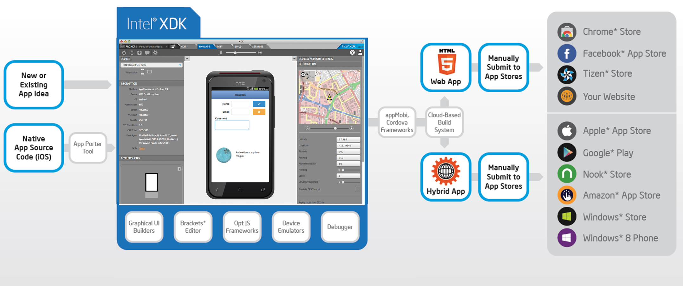
Intel® XDK Executive Summary
The Intel XDK tools facilitate the creation of hybrid HTML5 applications for deployment on iOS, Android, Windows 8, Tizen and other mobile devices.
Visit the Intel Developer Zone → software.intel.com/html5

Slide 4
What do these trend lines represent?
Notes:
Worldwide Devices Shipments by Operating System (Thousands of Units)
Source: Gartner (April 2013)
In the shares of operating systems (OSs) in device sales, the shift to mobile and the fight for the third ecosystem becomes more evident. Android continues to be the dominant OS in the device market, buoyed by strong growth in the smartphone market. Competition for the second spot will be between Apple's iOS/Mac OS and Microsoft Windows.
Note: Devices include notebooks and desk-based PCs, tablets, ultramobiles and mobile phones.
Source: Gartner (April 2013)

Slide 5
Platform Operating System Trends
Source: Gartner (April 2013)
www.gartner.com/newsroom/id/2408515
Notes:
Worldwide Devices Shipments by Operating System (Thousands of Units)
Source: Gartner (April 2013)
In the shares of operating systems (OSs) in device sales, the shift to mobile and the fight for the third ecosystem becomes more evident. Android continues to be the dominant OS in the device market, buoyed by strong growth in the smartphone market. Competition for the second spot will be between Apple's iOS/Mac OS and Microsoft Windows.
Note: Devices include notebooks and desk-based PCs, tablets, ultramobiles and mobile phones.
Source: Gartner (April 2013)

Slide 6
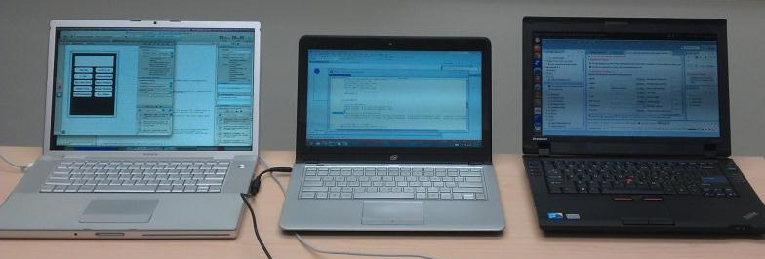



Creating Apps for Multiple Platforms…
*Xcode logo is the property of Apple
*Visual Studio logo is the property of Microsoft
*Android logo is the property of Google
Notes:
For many developers, supporting multiple platforms means they must maintain multiple code source bases using multiple Software Development Kits (SDKs) on multiple development platforms. For example:
to develop iOS native applications you must use the Apple Xcode development system which runs only on a Mac OS X system and utilizes Objective C as the primary programming language
to develop Android native applications you must use the Android Eclipse development system (on Windows, Mac or Linux) and utilizes Java as the primary programming language
to develop Windows 8 native applications you must us Visual Studio 2012 on a Windows 8 system and utilizes C#, JavaScript or C/C++ as the primary programming language(s)

Slide 7



…Requires Lots of Time and Money
Notes:
…working within these restrictions means having to work inside a set of walled gardens that prevent you from reaching the full potential of the mobile device market.

Slide 8
What’s Common Across these Platforms?
 | Apple* iOS* | BlackBerry* | Google* Android* | Microsoft* Windows* 8 | Mozilla* Firefox* OS | Tizen*
Development model | Controlled by Apple | Controlled by RIM | Code released to open source after first commercial device ships; key pieces are Google proprietary | Controlled by Microsoft | Open source, code released during development; controlled by Mozilla | Open source, code released during development. Controlled by Tizen TSG, co-chaired by Intel and Samsung
APIs | Objective C; HTML5 in browser and hybrid | C/C++; HTML5 in browser and hybrid; Java | Java; some C/C++; HTML5 in browser and hybrid | C/C++; C#, JavaScript; HTML5 in browser and hybrid | HTML5 only | HTML5 preferred; C/C++
Architecture support | ARM only | ARM only | ARM and x86 | ARM and x86 | ARM only | ARM and x86
Device categories supported | Smartphone, tablet, TV | Smartphone, tablet | Smartphone, tablet, TV | Smartphone, tablet | Entry smartphone | Smartphone, tablet IVI, TV, PC
Notes:
So how can developers reach the full spectrum of mobile devices without being trapped by “Walled Gardens”?
Look closely at this chart, there is a common theme, something that can be used to create applications using a single programming technology: HTML5 (HTML + CSS + JavaScript)!

Slide 9
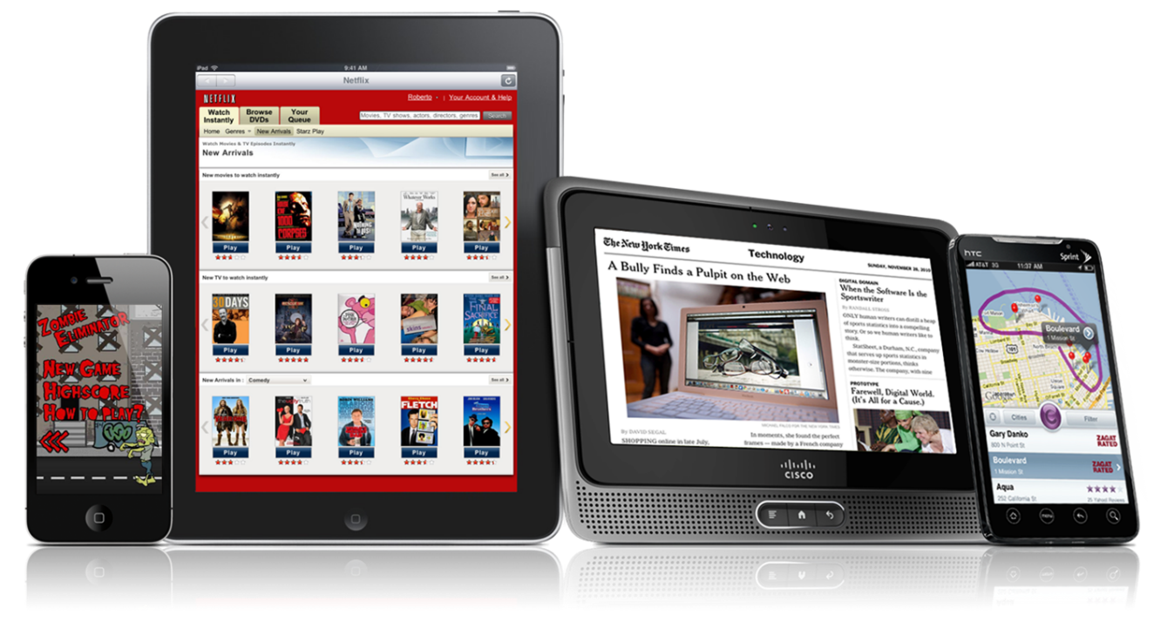
Why is HTML5 Interesting?
HTML5 is the language of the web!
It is flexible, adaptable and used by millions of developers.

Slide 10

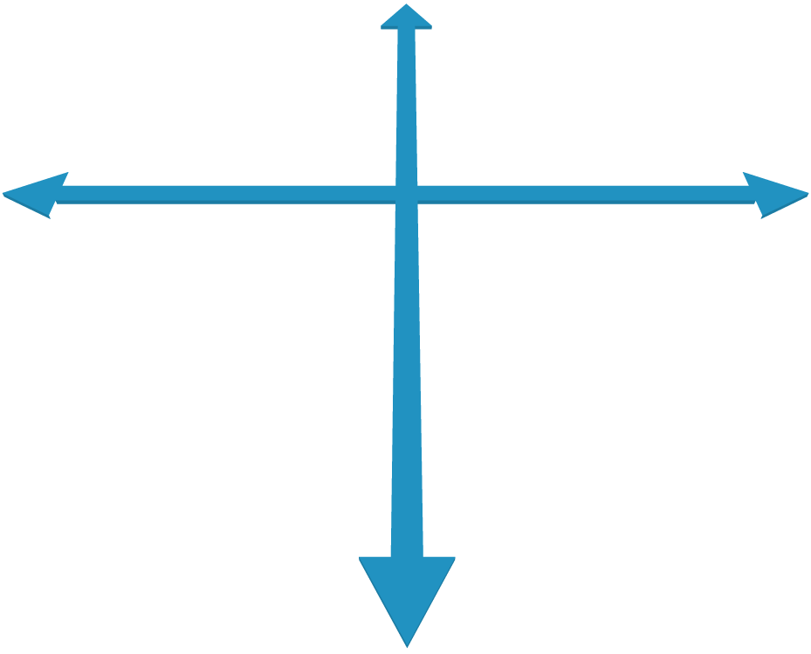








Native Versus Web Apps on Mobile
Native Apps
Advanced UI interactions
Fastest performance
App store distribution
Single Platform
Partial Capabilities
Full Capabilities
Web Apps
Web developer skills
Instant updates
Unrestricted distribution
Multiple Platforms
Notes:
Native Apps- Built using the native programming language for the platform (iPhone and iPad apps are built using Objective-C and Android are built with Java). Native apps are fast, provide a native user experience and interface and have access to all device features on the platform. The down side of native apps are their restricted reach: e.g., an android app cannot be run on an iPhone and vice versa. If you want to cover a larger target market, across all platforms, you must build separate native apps for each target.
Web Apps - A website built using HTML5, CSS3 and JavaScript which resembles an application and can be accessed through a browser is called a web app. The biggest advantage of web apps is that it can be used across all platforms and devices. However, web apps are not accepted in any of the native app stores thereby cutting off an important distribution channel for app developers. Also, web apps cannot access or use the native APIs or device specific hardware features.

Slide 11

Hybrid HTML5 App Advantage
Native Apps
Advanced UI interactions
Fastest performance
App store distribution
Single Platform
Partial Capabilities
Full Capabilities
Web Apps
Web developer skills
Instant updates
Unrestricted distribution
Hybrid HTML5 Apps
Web developer skills
Access to native platform
App store distribution
Multiple Platforms
Notes:
Native Apps- Built using the native programming language for the platform (iPhone and iPad apps are built using Objective-C and Android are built with Java). Native apps are fast, provide a native user experience and interface and have access to all device features on the platform. The down side of native apps are their restricted reach: e.g., an android app cannot be run on an iPhone and vice versa. If you want to cover a larger target market, across all platforms, you must build separate native apps for each target.
Web Apps - A website built using HTML5, CSS3 and JavaScript which resembles an application and can be accessed through a browser is called a web app. The biggest advantage of web apps is that it can be used across all platforms and devices. However, web apps are not accepted in any of the native app stores thereby cutting off an important distribution channel for app developers. Also, web apps cannot access or use the native APIs or device specific hardware features.
Hybrid Apps – A hybrid app is built using web technology and then “wrapped” in a platform specific container. The native container makes hybrid apps installable on a target device, just like a native app and, therefore, is eligible to be submitted to the platform’s app store. Developers can include hooks to native features in the container, in order to access native APIs and use device-specific hardware features. A hybrid app is basically an app developed in using a combination of HTML5 web technology and native platform technology. For cross-platform reach, developers would need to code the native part separately for each platform, but they can use the same HTML5 across all of their target platforms. Fortunately, technologies like Cordova (PhoneGap) and the Intel XDK make the process of developing the target container code a non-issue.

Slide 12




Why Hybrid HTML5 Apps?
Hybrid Apps allow developers to build apps with these skills and tools…
…that can be distributed in native app stores.

Slide 13
Web vs. Hybrid vs. HTML5 Applications
Today
Tomorrow
 | Web App limited sensor input | Hybrid App full sensor input | HTML5 App full device access
Runs w/o network | Yes | Yes | Yes
Flexible Layout | Yes | Yes | Yes
Device APIs | Limited | Mostly | Complete
Distribution | URL | Native Binary | URL/WGT
Cross Platform | Yes | Yes & No | Yes
Runs in Web Browser | Yes | No | No
Runs in Web Runtime | No | Yes | Yes
The HTML5 standard is evolving to include device APIs
Notes:
Before we venture into the world of building HTML5 mobile device applications it is worth talking about the different kinds of HTML5 apps that exist today. Today there are primarily two types of HTML5 applications: “web apps” and “hybrid apps.”
Web apps are really just a web page that appears like an app on a device, but does not actually “install” on that device, it runs inside the mobile device’s browser and is served up by a web server over the Internet. On iOS (Apple) devices there are clever techniques available to hide the fact that you are viewing a web page, special “tags” can be used inside your HTML page(s) to place an icon on an iOS desktop that instructs the browser to load and run this web site. Also, pages within such a “web app” can be cached locally, on the device, in order to accommodate a faster startup that does not depend on a network connection. However, ultimately, these are nothing more than clever URL bookmarks saved on the device screen. These apps cannot be hosted in the Apple store nor are they every truly “installed” on the device.
And, unfortunately, this “web app bookmark” trick that works so nicely on iOS devices does not work on Android and other mobile devices. More importantly, these special “web apps” do not have access to device features like the accelerometer, compass, GPS, camera(s), contacts, etc. They are limited by browser security restrictions, and therefore are not considered to be “trusted” applications for the purpose of device and user data access.
“Hybrid apps” can be thought of as “web apps” that have been “wrapped” inside a native container so the application can actually be submitted to a device store (Apple store, Android store, etc.) and downloaded for installation on a user’s mobile device. In addition, because hybrid apps are installable apps they have access to device features, so they can more intimately interact with the end user.
An “HTML5 app” goes one step beyond a hybrid app. A true HTML5 app is a collection of the HTML5 files (HTML, CSS, JavaScript and related asset files, such as image files) that make up the application. In this case, the collection of files are delivered in a signed ZIP format that is recognized by the target system as a “runnable” application that can be “installed” on the device. Firefox OS applications and Tizen HTML5 applications are such HTML5 apps (of tomorrow). They do not require a special “wrapper” or “container” to turn them into native executables that can be installed and run on a device, they consist only of the HTML5 parts that are necessary to run as HTML5 applications. And the device platform (e.g., Firefox OS and Tizen) provides a complete JavaScript API that allows the applications access to device-specific features, such as sensors, cameras, contact databases, SMS messaging, etc. – access to features you cannot get from a typical browser.
The last two rows of this table are particularly important. Notice that hybrid apps and the HTML5 apps (of tomorrow) run inside a “web runtime” as opposed to inside a web browser. This is a very important distinction. The “web browser” is that agent you normally use to “browse the web.” It is Chrome or Firefox or IE or Opera or Safari… The “web runtime” or “webview” is a builtin native programming object that can be used by native applications to display web content within a window or “view” as part of the native application. The “native container” that “wraps” an HTML5 hybrid application uses this webview to run the HTML5 application on a device.
While the “web browser” on a device can be easily updated by redistributing and installing a new browser (for instance, by installing a new instance of the Chrome browser on your Android device), the builtin “web runtime” or “webview” is not so easily updated. It is generally built into the ROM of the device and will only be updated if the device OS is updated. Additionally, there may be features present in the mobile browser (e.g., Safari on iOS and Chrome on Android) that do not exist within the webview. It is important to understand this distinction because it can impact how you write your HTML5 application as well as how you debug that application. Some typical differences include a more limited memory footprint as well as more limited use of hardware acceleration (this especially impacts certain CSS features). In essence, you cannot assume that just because something works well in a browser that it will work equally well in a webview.
Web Apps:
‘Pure’ HTML/CSS/JavaScript. Typically, just a URL that will run in a browser
Universal across platforms
Limited or no access to device data and sensors (GPS, Accelerometer,…)
Hybrid Apps:
Mostly HTML5, but wrapped in a ‘native webview’
Must be build for each platform.
Distributed as native executable
Packaged as native apps
JavaScript APIs for access to device data
HTML5 Apps:
Web Apps with Device Data access through standardized APIs
App code stored locally

Slide 14
Hybrid HTML5 App Block Diagram
Your HTML5 Web App
Hybrid Extension
Native WebView
Mobile System Services
Mobile Operating System
Mobile Device Hardware
Notes:
This very simple block diagram does not represent all the interactions between the hybrid extension or container, the webview and the underlying native platform. However, it should give you a sense of how a hybrid HTML5 application works. Your HTML5 application talks directly with the container’s extension JavaScript library (e.g., cordova.js or intelxdk.js). It then interacts with platform-specific code to provide the native device features that can only be executed outside the webview.

Slide 15
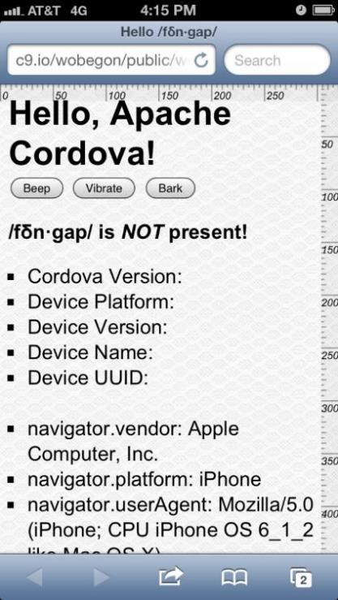
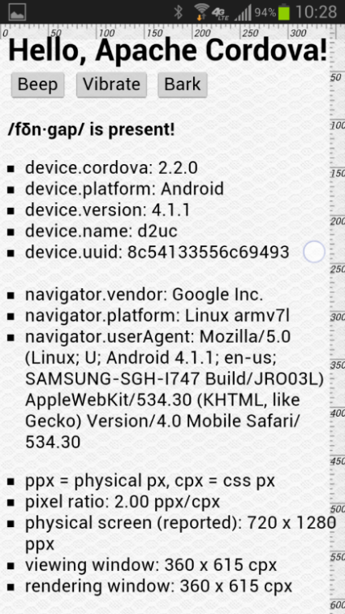
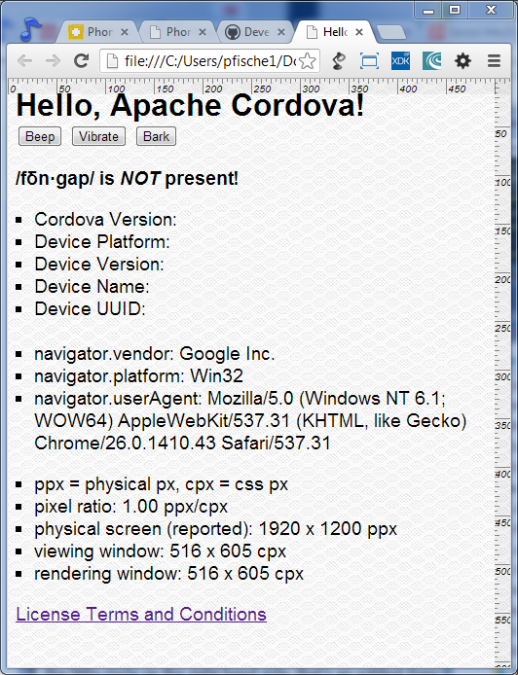
Inside a Browser vs. Inside a WebView
Desktop Browser
Mobile Browser
Native WebView
Notes:
These three images show a simple web app that requires access to some device specific features (simply reporting some device data) that is only available to a native application. The first two screenshots are of the application running inside a browser: the first is running in the Chrome desktop browser running on a Windows laptop and the second is the application running inside a mobile browser on an iPhone.
The third screenshot shows the application running inside a webview on an Android phone. Note how only the third screenshot includes the device-specific data that can only be obtained with device access. Also, notice how the third screenshot does not contain any browser “chrome,” meaning there is no address bar, there are no browser tabs and there are no browser navigation elements. Even though this is an HTML5 application it occupies the entire screen, like any native application would.

Slide 16
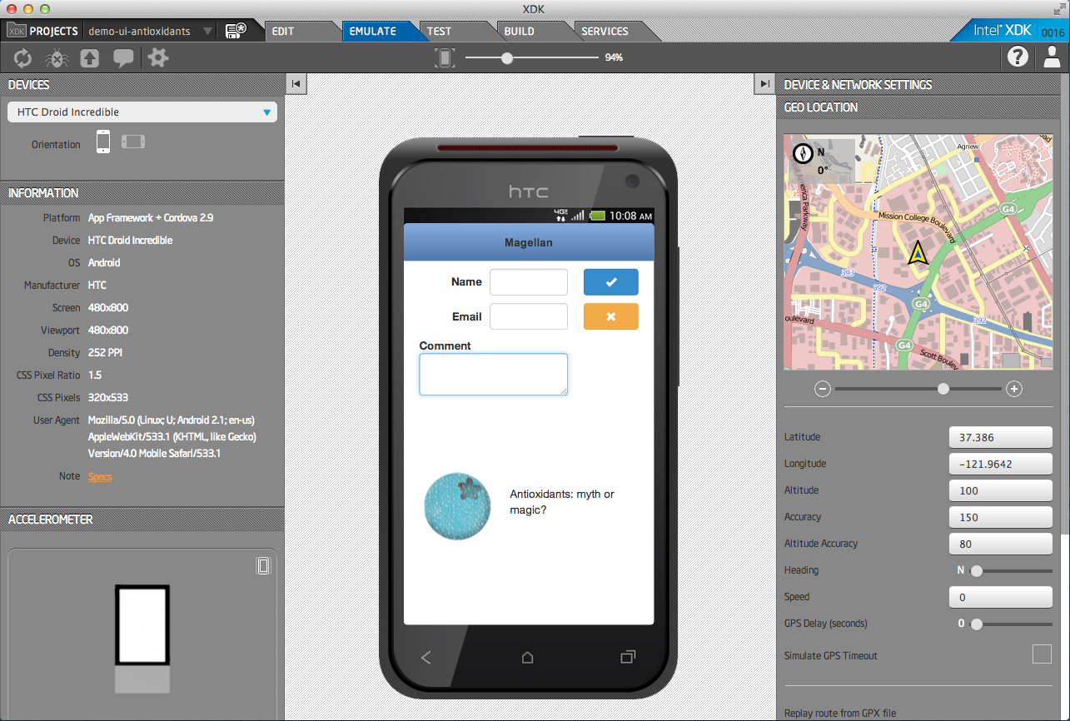

Intel® XDK – Tools for Hybrid HTML5 App Development
Develop
Debug and Test
Deploy
HTML5 Editor
Device
Emulator
JS Debugger
Cloud-Based Packaging Tool
App Designer
UI Layout
On-Device
App Tester
On-Device
App Debugger
Cordova Build
“Hybrid Apps“
Apple* AppStore
Google* Play*
Windows* Market
App Framework
Optimized JS libs
HTML5 Build
“Web Apps“
Chrome* Store
Facebook*
Your Website
App Game I/F
Optimized Canvas
App Porter
Convert iOS to HTML5
Build cross-platform HTML5 hybrid applications.
*HTML5 logo is the property of World Wide Web Consortium (W3C)
Notes:
http://www.w3.org/html/logo/ -- HTML5 logos are released under Creative Commons Attribution 3.0 License.
You are free:
to Share — to copy, distribute and transmit the work
to Remix — to adapt the work
to make commercial use of the work
Under the following conditions:
Attribution — You must attribute the work in the manner specified by the author or licensor (but not in any way that suggests that they endorse you or your use of the work).

Slide 17
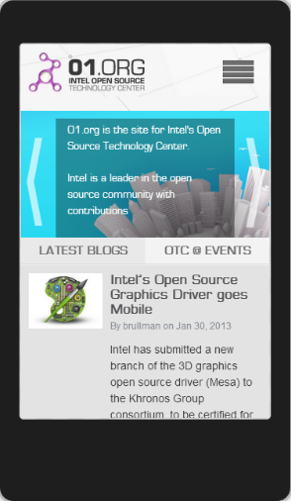
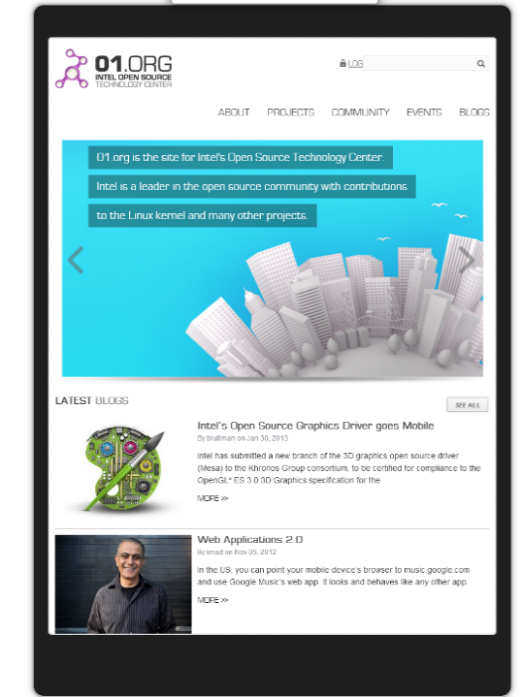
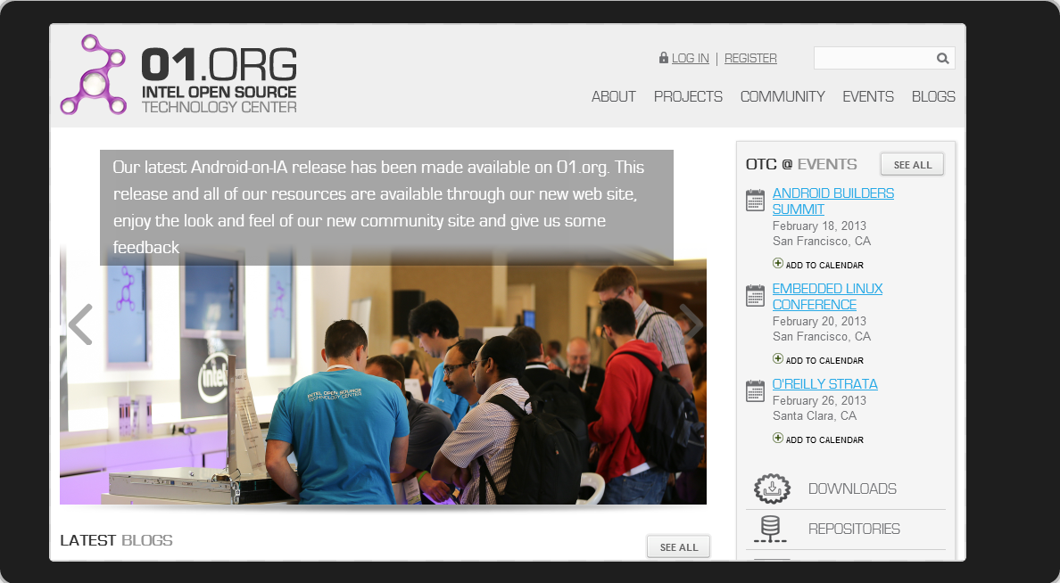
Use HTML/CSS/JS for UI and Program Logic…

Slide 18
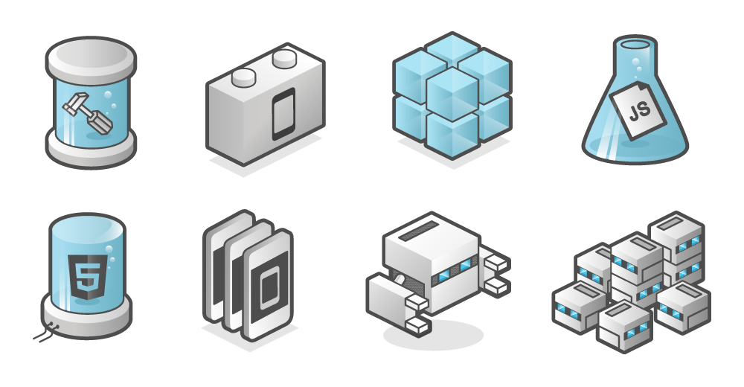
…and /fōn•gap/ for Device Feature Access

Slide 19
Installation Logistics
If possible, before the event, email instructions to attendees to download and install the Intel XDK onto their laptop (Windows, Linus or Mac) before the class begins. They will also need to create a user account.
Suggest that they bring a mobile device with them (Android or iOS) in the event they want to try installing an app onto it – and suggest that they install the App Previewer (currently called App Lab) application for testing if they have an Android or iOS device (AppMobi not Intel).
Show a slide explaining where to download the XDK.
Bring several USB flash sticks to give to attendees so they can install the XDK off-line, however, for the full class they will need Internet access.
Hidden Slide for Instructor

Slide 20
Installation of the Intel XDK
Download the Intel XDK → html5dev-software.intel.com
Create a userid and password
Intel email address is okay or personal email address
Double-check your online account by logging in here → appcenter.html5tools-software.intel.com
Download and install App Previewer (aka App Lab)
For your Android device → play.google.com/store/apps/details?id=com.appMobi.applab
For your iOS device → itunes.apple.com/us/app/app-lab/id395691569?mt=8
XDK Lab samples can be found here → github.com/xdklab

Slide 21

Activity #1 Layout and Design

Slide 22
Develop: Mobile App Design Tools
Develop
Debug and Test
Deploy
HTML5 Editor
Device
Emulator
JS Debugger
Cloud-Based Packaging Tool
App Designer
UI Layout
On-Device
App Tester
On-Device
App Debugger
Cordova Build
“Hybrid Apps“
Apple* AppStore
Google* Play*
Windows* Market
App Framework
Optimized JS libs
HTML5 Build
“Web Apps“
Chrome* Store
Facebook*
Your Website
App Game I/F
Optimized Canvas
App Porter
Convert iOS to HTML5
Build cross-platform HTML5 hybrid applications.
Notes:
http://www.w3.org/html/logo/ -- HTML5 logos are released under Creative Commons Attribution 3.0 License.
You are free:
to Share — to copy, distribute and transmit the work
to Remix — to adapt the work
to make commercial use of the work
Under the following conditions:
Attribution — You must attribute the work in the manner specified by the author or licensor (but not in any way that suggests that they endorse you or your use of the work).

Slide 23
Summary: Mobile App Design Tools
HTML5 Built-in Editor
Based on Brackets* --or-- use your favorite editor
App Designer
Drag-n-drop UI components
Configure media query switch [wrap] points
Compatible with multiple UI frameworks
App Framework
jQuery* compatible UI framework
Optimized for mobile device web views
Android*, iOS*, Blackberry* and Windows 8* themes
app-framework-software.intel.com/style.php
App Game Interface
Accelerated canvas for Android* and iOS*
Multi-channel audio and Box2D* physics engine support
Notes:
App Framework was built from the ground up to excel on mobile devices by being light and fast. It takes advantage of new browser features and supports valid W3C CSS selectors. User generated performance tests at jsperf.net have shown it to be faster than every other JavaScript* library available.
App Framework UI, also known as AFUI, is the only mobile framework that treats Android*, iOS*, Blackberry* and Win8* the same. In other words, AFUI does not degrade features or performance in order to resolve conflicts or bugs. For example, most frameworks consider Android* to be "broken" and ignore specific versions of that operating system or take shortcuts that perform poorly. App Framework solves these key issues to provide a clean and responsive HTML5 user interface.
Plugins are separate JavaScript libraries created to augment apps written using App Framework App Framework. Plugins provide useful features or functionality that may be outside the scope of basic applications. App Framework UI harnesses a few of the core plugins like jq.scroller.js and jq.css3animate.js.
The App Game Interface technology has solved two very important issues that face developers who want to create animated mobile games using HTML5.
Issue #1: Poor Game Frame Rate
The first and most vexing problem is poor overall game performance due to slow graphic rendering in the HTML5 browser. App Game Interfaces is an elegant solution that allows HTML5 games to truly match the user experience of native games.
Issue #2: Single Channel Sound with Poor Response Time
The second problem is HTML5's inability to play multiple sounds, and its inability to reliably play sound in sync with game events. App Game Interfaces eliminates these limitations, allowing games to play unlimited sounds simultaneously, and with no latency or lag time.
How does it work?
Modern WebKit browsers perform an amazing amount of processing in order to convert HTML5 canvas commands into a fully rendered page. Reflowing text, mapping hot spots, creating indexes for reference links, on and on. A typical game requires none of this functionality, but the processing overhead is still there.
Fixes HTML5 Audio Issues
HTML5 was not designed to play multiple asynchronous sounds with low latency, yet that's exactly what games need to do. App Game Interface's polyphonic technology allows each entity in your game to play sound when it needs to, without regard to any other concurrent sounds. The only limitations are those classic issues - memory and storage.
Box2D* support
Many physics-based games are being created using the very popular Box2D physics library. App Game Interfaces has a highly optimized JavaScript bridge to C+ that accelerates the Box2D calculations.

Slide 24
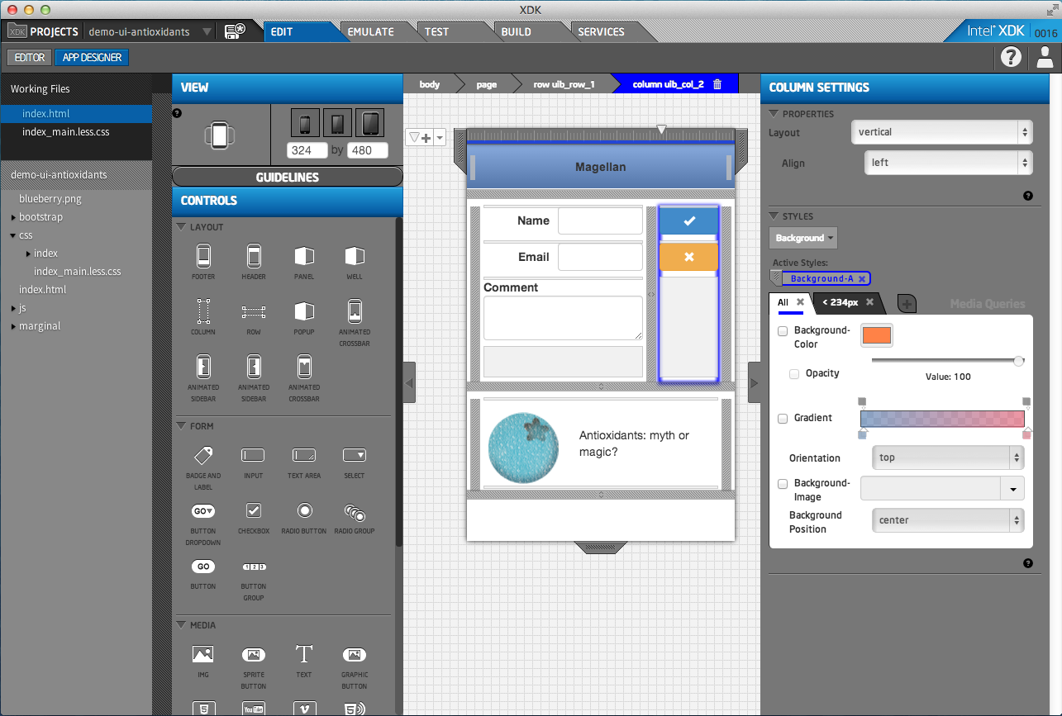
Exercise: Mobile App Design Tools

Slide 25
Activity #1
Introduction to the Brackets editor
Introduction to App Designer
Introduction to App Starter and App Framework
Have attendees explore features of Brackets editor (esp. Quick Docs and Quick Edit – see right-click menu)
Have attendees play with an existing UI in a sample application and modify it using App Designer
Have attendees modify themes for App Framework using the App Starter theme roller
Hidden Slide for Instructor

Slide 26
Activity #2 Test and Debug

Slide 27
Test: Emulate and On-Device Debug
Develop
Debug and Test
Deploy
HTML5 Editor
Device
Emulator
JS Debugger
Cloud-Based Packaging Tool
App Designer
UI Layout
On-Device
App Tester
On-Device
App Debugger
Cordova Build
“Hybrid Apps“
Apple* AppStore
Google* Play*
Windows* Market
App Framework
Optimized JS libs
HTML5 Build
“Web Apps“
Chrome* Store
Facebook*
Your Website
App Game I/F
Optimized Canvas
App Porter
Convert iOS to HTML5
Build cross-platform HTML5 hybrid applications.
Notes:
http://www.w3.org/html/logo/ -- HTML5 logos are released under Creative Commons Attribution 3.0 License.
You are free:
to Share — to copy, distribute and transmit the work
to Remix — to adapt the work
to make commercial use of the work
Under the following conditions:
Attribution — You must attribute the work in the manner specified by the author or licensor (but not in any way that suggests that they endorse you or your use of the work).

Slide 28
Summary: Emulate and On-Device Debug
Intel® XDK Emulator
Preview in various phone and tablet formats
iPhone*, iPad*, Android* devices, Windows* 8 tablet…
Simulate device-specific features
accelerometer, compass, GPS, vibrate, orientation…
Debug using standard Chrome DevTools (CDT)
Simulation of intel.xdk and cordova APIs
Intel XDK 4.0.0 and Cordova 2.9.0 API levels
App Tester → On-Device Previewer
Quickly load and run projects directly on real devices
Access to indel.xdk and cordova device APIs
App Debugger → On-Device Remote Debug
Remote access to device JavaScript console (aka CDT)
Notes:
The Intel XDK makes it easy for developers to check the look and feel of their apps using on-screen emulation of a wide variety of devices. The App Tester allows you to test on a physical device.

Slide 29
Exercise: Emulate and On-Device Debug

Slide 30
Activity #2
Take an existing complete sample app and run it in the emulator.
If you have a mobile device available, install App Previewer (App Lab) and run a sample app on your device with App Tester.
Modify a sample app per instructions provided by instructor.
Debug in the emulator using Chrome Dev Tools and App Tester (for those that have devices).
Load the app into App Tester but with weinre enabled, and see what you can debug using the remote inspector.
Plan to spend a significant time on this section, it will have the most interesting and difficult parts.
Hidden Slide for Instructor

Slide 31
Activity #3 Package and Build

Slide 32
Deploy: Package and Build
Develop
Debug and Test
Deploy
HTML5 Editor
Device
Emulator
JS Debugger
Cloud-Based Packaging Tool
App Designer
UI Layout
On-Device
App Tester
On-Device
App Debugger
Cordova Build
“Hybrid Apps“
Apple* AppStore
Google* Play*
Windows* Market
App Framework
Optimized JS libs
HTML5 Build
“Web Apps“
Chrome* Store
Facebook*
Your Website
App Game I/F
Optimized Canvas
App Porter
Convert iOS to HTML5
Build cross-platform HTML5 hybrid applications.
Notes:
http://www.w3.org/html/logo/ -- HTML5 logos are released under Creative Commons Attribution 3.0 License.
You are free:
to Share — to copy, distribute and transmit the work
to Remix — to adapt the work
to make commercial use of the work
Under the following conditions:
Attribution — You must attribute the work in the manner specified by the author or licensor (but not in any way that suggests that they endorse you or your use of the work).

Slide 33
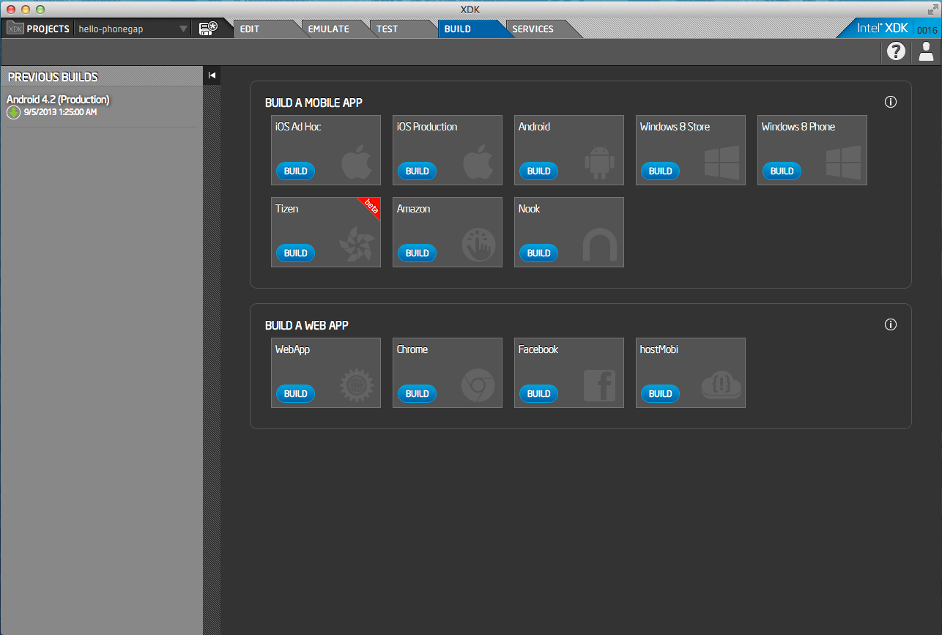
Summary: Package and Build

Slide 34
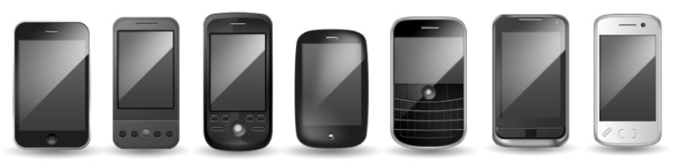
Exercise: Build for a Supported Platform
 | Intel® XDK† | Adobe* PhoneGap* Build* | Other Options (typical)
iOS* | Χ | Χ | Χ
Android* | Χ | Χ | Χ
Windows* 8 | Χ
Blackberry* |  | Χ
Tizen* | Χ
FireFox* OS
ChromeOS* | Χ
Web App | Χ
†Build support as of September, 2013
Notes:
This chart is a simple comparison of the Adobe PhoneGap Build service, the Intel XDK and what is typically available from most other build services, as of August, 2013.
Intel XDK build support also includes: Amazon and Nook (Android variants) and Facebook (web app).
Typically, other build services (excepting Adobe PhoneGap Build) only support building to the Android and iOS platforms.

Slide 35
Activity #3
Take an existing sample app or the one that was worked on in the previous activity through the build process.
If users have a device, install that app on the actual device and confirm that it installs and runs. This will be easiest with an Android device, since an iOS requires a developer ID even to perform an ad hoc install, as well as a provisioning process for the specific device.
Hidden Slide for Instructor

Slide 36
Intel® HTML5 App Porter Tool - BETA
Helping iOS* Developers Broaden Their Market Reach Through HTML5

Slide 37


You Have Deployed an iOS* App...
Your App
...but you want to broaden your market reach...
…translate your application from Objective C to HTML5
Apple*
App Store
Windows*
Store/Windows*
Phone Store
Google*
Play*
Facebook* Store
Chrome* Store
Own Website

Slide 38


iOS* to HTML5 Translation Process
Original iOS* App
Translated HTML5 App
Existing app source code written in
Objective-C*
Each .m and .c file is translated into an equivalent .js file
New app source code written in
JavaScript
Each XIB view is translated into editable HTML and CSS
XIB Files + Resource Files
HTML + CSS + Resource Files
Application Code
System and Library Code
iOS SDK Stack
Intel® HTML5 App Porter
Tool - BETA Library
jQuery Mobile
HTML5 API
System API calls are translated into calls to standard HTML5 API and other JS libraries

Slide 39
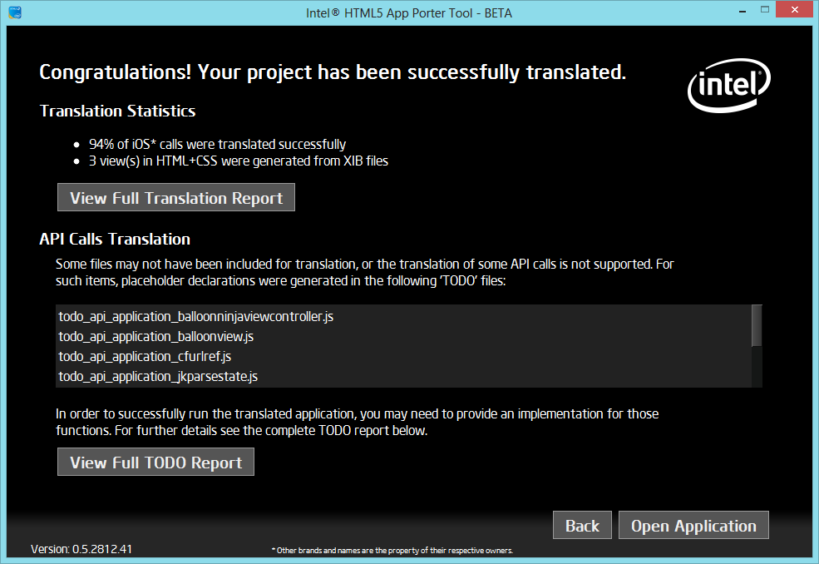
Demo: iOS* to HTML5 Translation
39

Slide 40

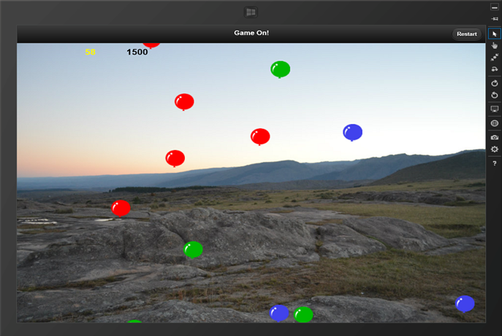
iOS* to HTML5 Translation → Before and After Shots
iOS* App
Translated HTML5 App

Slide 41
Questions & Answers

Slide 42

Additional Sources of Information
software.intel.com/html5
html5dev-software.intel.com
wiki.apache.org/cordova
app-framework-software.intel.com
github.com/01org/appframework
app-framework-software.intel.com/style.php

Slide 43
Backup Slides

Slide 44



Why Does Intel Love HTML5?
HTML5 is advanced
Intel takes HTML5 further with new APIs and Parallel JavaScript
HTML5 is open
Intel advances HTML5 via open source projects and the W3C
HTML5 is everywhere
Intel supports HTML5 developers with new tools and communities
Learn more at software.intel.com/html5
Notes:
Why does Intel Love HTML5?
Intel’s vision for the future is a world where developers can create amazing experiences that flow freely from device to device, and screen to screen.
HTML5 helps make that world possible
HTML5 is advanced
HTML5 is a collection of proven web technologies with advanced features (such as storage, security and offline capabilities).
Intel is working to take HTML5 even further. As an active contributor to the W3C, we’re developing APIs for new device, security and media capabilities.
And, we’re helping enable a more powerful, immersive HTML5 platform through Parallel JavaScript* technology.
HTML5 is Open.
Built on open web technologies and W3C standards, HTML5 gives developers more freedom, power and choice.
Intel is a long-time supporters of open technologies, from Linux to HTML5 and beyond.
We’re helping to advance HTML5 and keep it open through extensive contributions to open-source projects like WebKit.
We’re collaborating to add new features to HTML5 through active participation in W3C working groups.
And, we help put HTML5 resources at your fingertips as a steward of Web Platform Docs.
HTML5 is everywhere
HTML5 is broadly supported across all major browsers and the web runtimes of many mobile platforms. Put simply, you can reach more devices and more users—more efficiently—with HTML5.
At Intel, we’re supporting developers with the tools and community. From development to deployment, everything developers need is at the Intel® HTML5 Zone.
See how Intel is helping developers reach their full cross-platform potential by going to software.intel.com/html5 today.
How will Intel ensure HTML5 developers do not get trapped into walled gardens?
With HTML5 technology new to many developers, education, guidance, and tools are keys to helping these developers deliver cross platform HTML5 applications for a variety of devices and environments. Intel offers one of the world’s largest software developer program and by channeling resources through the HTML5 portal on Intel Developer Zone developers will have access to resources to help them develop and deliver applications that can run across boundaries. As an OS-neutral advisor, Intel can offer important HTML5 technical resources that will help developers to write once, and deploy across multiple platforms. Coming in the next few months, you will see new tools and resources plus a vibrant HTML5 community on the Intel Developer Zone.

Slide 45
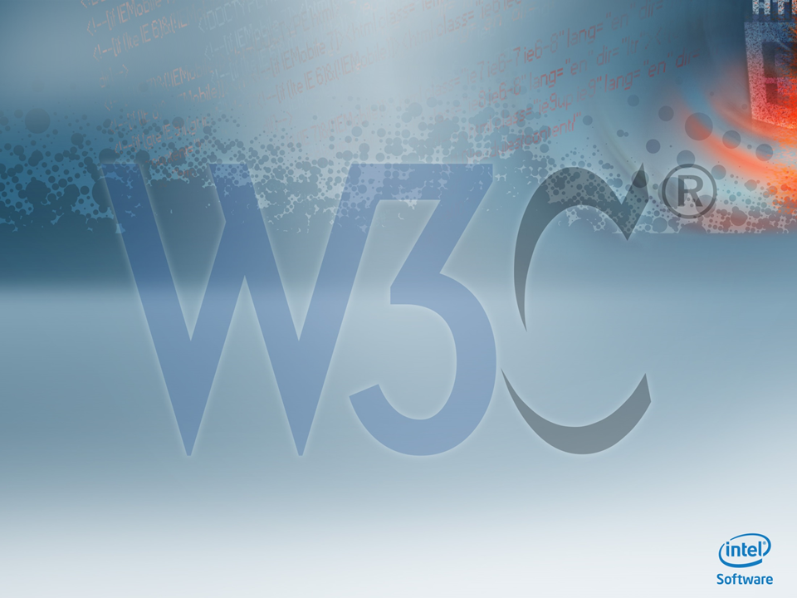









Taking HTML5 Further
W3C Web
Applications WG
W3C Device
API WG
Improve client-side application development on the web
W3C HTML WG
Enable web application interaction with device HW, services, and applications
HTML5 core, elements, layouts, DOM
W3C Audio WG
W3C CSS WG
Add more advanced audio capabilities, such as the processing and synthesis of audio streams
W3C WebApp
Security WG
Develop and maintain cascading style sheets
3 Intel members
Security and policy mechanisms to improve security of web applications
2 Intel members
W3C NFC WG
W3C System
Applications WG
Develop ways for web pages to interact with NFC devices
W3C Web
Cryptography WG
Define runtime environment, security model and associated APIs to build web apps similar to native
Define cryptography APIs to provide common functionality to web applications
W3C
Browser Testing and Tools
W3C
Tracking Protection WG
Develop technologies for use in testing, debugging, and troubleshooting of web applications
W3C Web
Performance WG
Improve privacy and user control
Enhance application performance of user agent features and APIs
** Partial List as of January, 2013
Notes:
Intel is actively involved in shaping HTML5 as an open standard, with contributors who participate in more than half the W3C working groups, some of which you can see here
Intel leads the W3C’s Near Field Communications (NFC) Working Group, with the mission to develop a standard API for Web applications to access NFC devices
Intel is an active participant in the W3C Systems Application Working Group—the first group dedicated to defining and driving application API standards for HTML, JavaScript and CSS
We also host W3C API workshops, such as the W3C Automotive API Workshop in November 2012 in Rome

Slide 46
Application Platform Trends
Source: Gartner (April 2013)
www.gartner.com/newsroom/id/2408515
Notes:
Worldwide Devices Shipments by Segment (Thousands of Units)
Source: Gartner (April 2013)
The proliferation of lower-priced tablets and their growing capability is accelerating the shift from PCs to tablets. "While there will be some individuals who retain both a personal PC and a tablet, especially those who use either or both for work and play, most will be satisfied with the experience they get from a tablet as their main computing device," said Carolina Milanesi, research vice president at Gartner. "As consumers shift their time away from their PC to tablets and smartphones, they will no longer see their PC as a device that they need to replace on a regular basis."
The traditional PC market of notebooks and desk-based units is expected to decline 7.6 percent in 2013. This is not a temporary trend induced by a more austere economic environment; it is a reflection of a long-term change in user behavior. Beginning in 2013, ultramobiles will help offset this decline, so that sales of traditional PCs and ultramobiles combined show a 3.5 percent decline in 2013.
Worldwide tablet shipments are forecast to total 197 million units in 2013, a 69.8 percent increase from 2012 shipments of 116 million units. "Lower prices, form factor variety, cloud update and consumers' addiction to apps will be the key drivers in the tablet market," said Ranjit Atwal, research director at Gartner. "Growth in the tablet segment will not be limited to mature markets alone. Users in emerging markets who are looking for a companion to their mobile phone will increasingly choose a tablet as their first computing device and not a PC.“

Slide 47
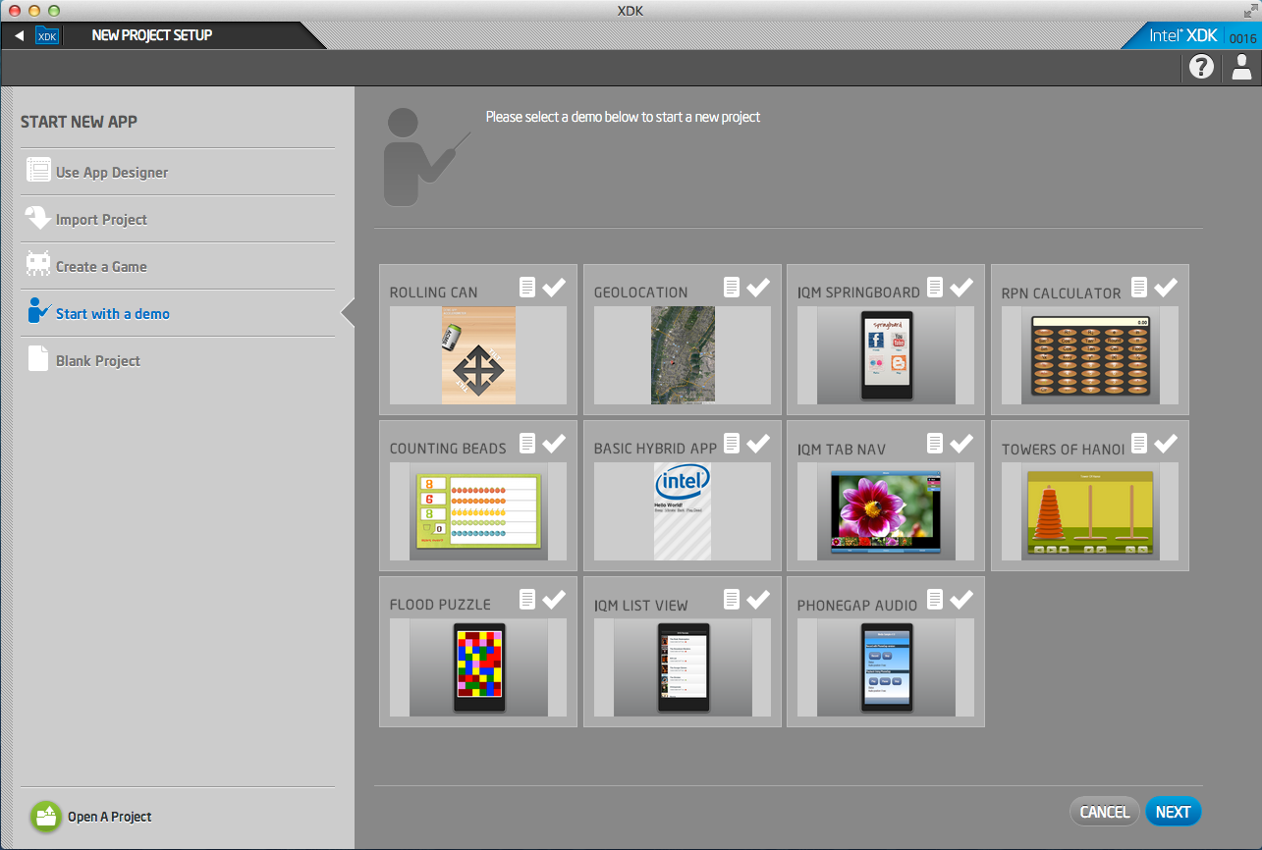
Starting From a Sample

Slide 48
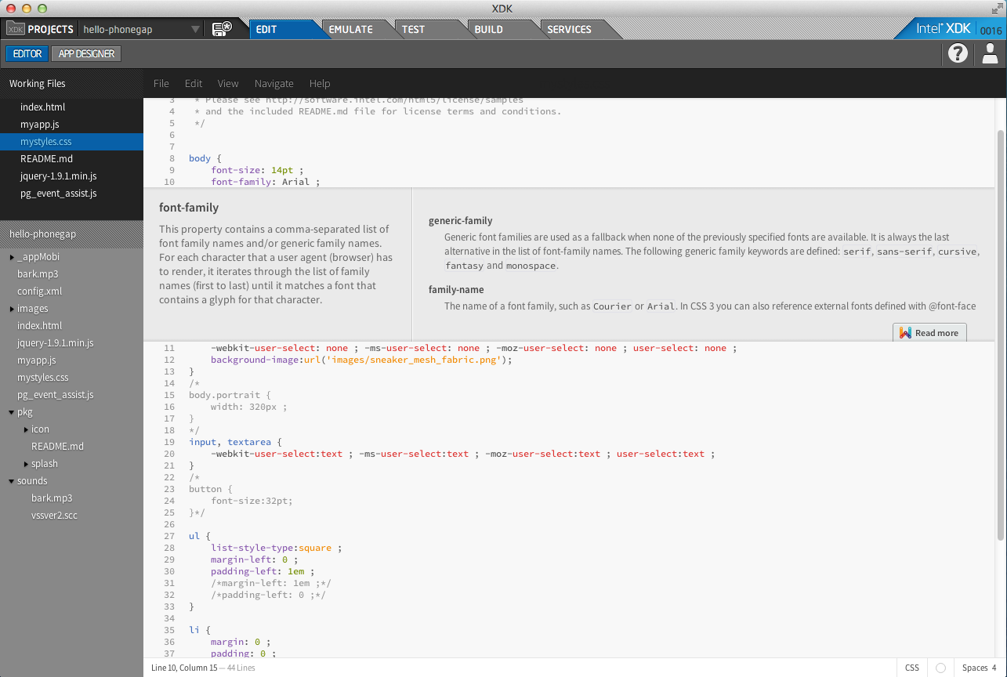
Integrated Brackets* Editor

Slide 49
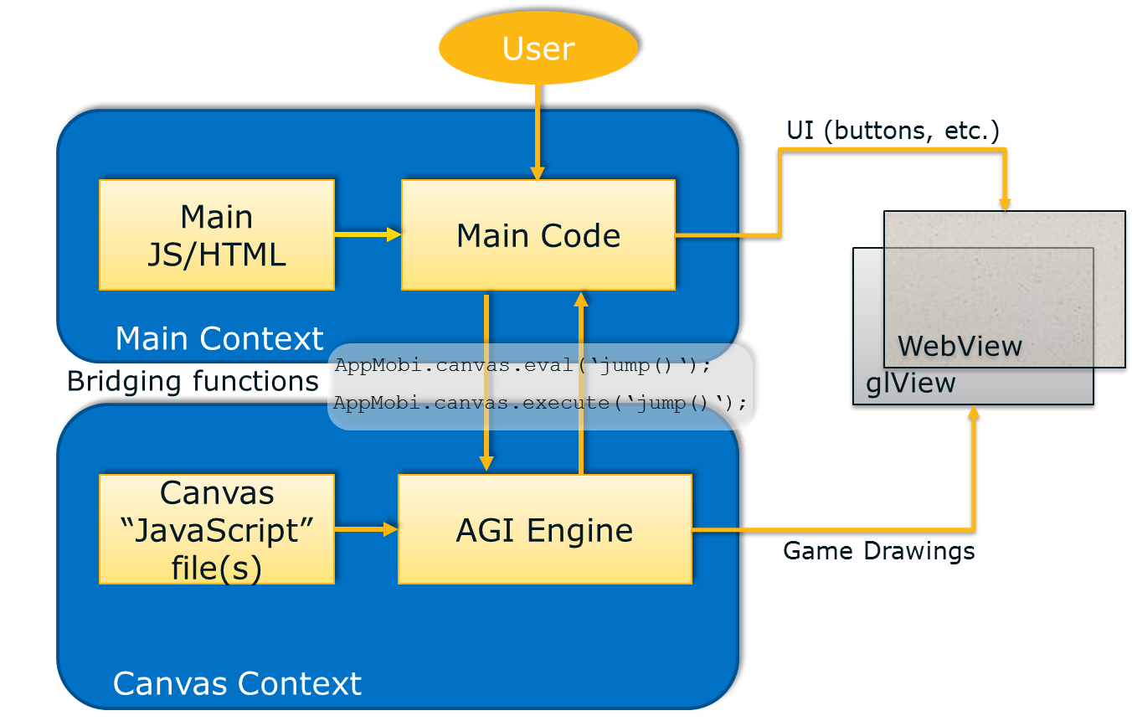
App Game Interface
App Game Interface, provides an accelerated Canvas implementation similar to HTML5 Canvas, along with multi channel sound, and accelerated physics, to enable more realistic modeling and smoother gameplay, for more native like capabilities and performance.
For iOS*, Android*, Windows*8
App Game Interfaces For Faster HTML5 Games
Notes:
The App Game Interface technology has solved two very important issues that face developers who want to create animated mobile games using HTML5.
Issue #1: Poor Game Frame Rate
The first and most vexing problem is poor overall game performance due to slow graphic rendering in the HTML5 browser. App Game Interfaces is an elegant solution that allows HTML5 games to truly match the user experience of native games.
Issue #2: Single Channel Sound with Poor Response Time
The second problem is HTML5's inability to play multiple sounds, and its inability to reliably play sound in sync with game events. App Game Interfaces eliminates these limitations, allowing games to play unlimited sounds simultaneously, and with no latency or lag time.
How does it work?
Modern WebKit browsers perform an amazing amount of processing in order to convert HTML5 canvas commands into a fully rendered page. Reflowing text, mapping hot spots, creating indexes for reference links, on and on. A typical game requires none of this functionality, but the processing overhead is still there.
Fixes HTML5 Audio Issues
HTML5 was not designed to play multiple asynchronous sounds with low latency, yet that's exactly what games need to do. App Game Interface's polyphonic technology allows each entity in your game to play sound when it needs to, without regard to any other concurrent sounds. The only limitations are those classic issues - memory and storage.
Box2D* support
Many physics-based games are being created using the very popular Box2D physics library. App Game Interfaces has a highly optimized JavaScript bridge to C+ that accelerates the Box2D calculations.

Slide 50
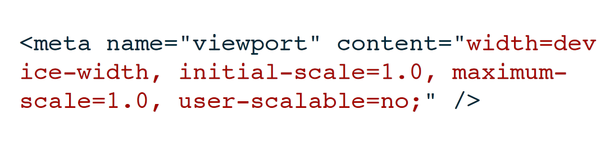
Typical Viewport Configuration
Notes:
It is important to understand that the displayable area on a mobile device has a slightly different layout than what is found in a standard desktop browser. Most important is the concept of a “CSS pixel” and a “virtual viewport.” See this article to start with: http://www.quirksmode.org/blog/archives/2010/04/a_pixel_is_not.html and this article: http://alistapart.com/article/a-pixel-identity-crisis.
This video is of the guy who wrote the first article (above) and is very helpful: https://thenewcircle.com/s/post/1141/a_pixel_is_not_a_pixel_ppk_explains_viewports.
By specifying width=”device-width”, you are asking the browser to apply a scaling factor to its screen pixels to match the width of the device screen. In most cases the screen width divided by the css pixel ratio is approximately 320 or 360. By specifying width=”device-width”, you transform the browser window (or viewport) into a 320 (or so) pixel wide display that matches the physical width of your mobile device.
initial-scale
The initial zoom of a web page. Its scale is a multiplier out of a web page. 1.0 does not allow any zooms. Its scale is from 0 to 10.0.
minimum-scale
The minimum multiplier the user is able to zoom out of a web page. 1.0 does not allow any zooms. Its scale is from 0 to 10.0.
maximum-scale
The maximum multiplier the user is able to zoom in to a web page. 1.0 does not allow any zooms. Its scale is from 0 to 10.0.
user-scalable
The permission (yes/no) as to whether the user is able to control the scale (zoom in/out) of the web page or not. The default value is yes.

Slide 51
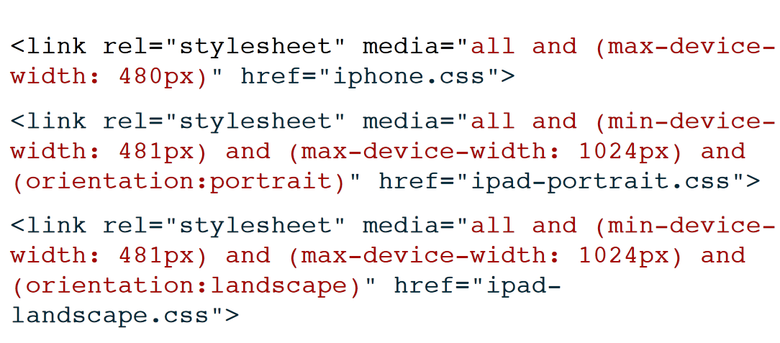
Typical Media Query
Notes:
Media queries in CSS3 help HTML5 applications utilize different properties and rules for your CSS styling. Media queries allow developers to target specific devices and adapt to characteristics of a device, in order to target styling attributes based on orientation, device-aspect-ratio, color or resolution.
There are three ways to define CSS media queries.
1) In the <style> element as media rules:
<style type= "text/css" >
@media only screen and ( -webkit-min-device-pixel-ratio : 1 .0 ) {
/* some CSS definitions here */
}
@media only screen and ( orientation : portrait ) {
/* some CSS definitions here */
}
@media only screen and ( orientation : landscape ) {
/* some CSS definitions here */
}
</style>
2) As an external include:
<link rel= "stylesheet" type= "text/css" href= "small_screen.css" media= "only screen and (max-width: 320px)" />
3) Or, by importing the stylesheet:
@import "small_screen.css" only screen and (max-width: 230px) ;

Slide 52
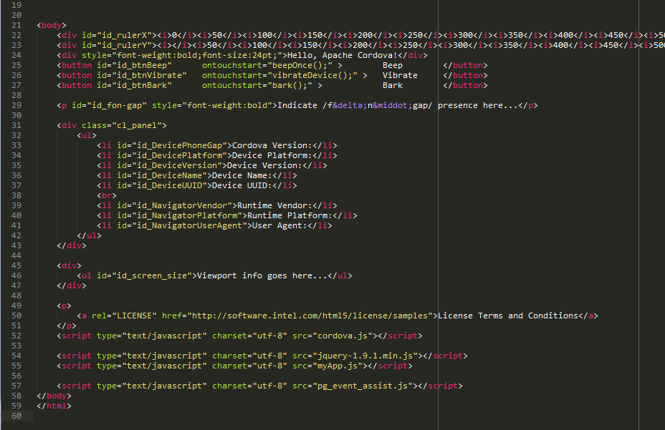
Load Your Script Files Locally, Not via a CDN

Slide 53
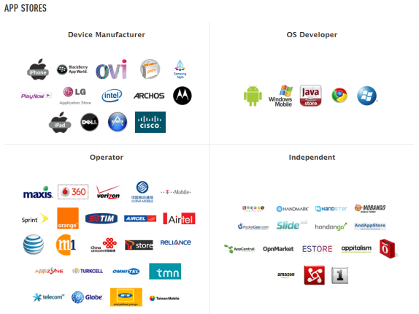
HTML5 Device Application Challenges
App Store Fragmentation
Performance
Debugging
Testing
Device APIs
Security
etc.
Notes:
HTML5 apps need to be ported to different form factors and for different monetization systems, different stores…
scaling to multiple form factors
multiple billing systems (~58 app stores available: OEMs, Carriers, OSVs, Independent http://www.distimo.com/appstores/)
app submission processes, artwork/paperwork requirements, app certifications, approval criteria, revenue model options, payment terms, taxation and settlement terms
Benefits of native apps:
“Feels” better to the end-user (native UI elements).
Perceived to be more responsive (doesn’t run on web layer).
Access to hardware and persistent data storage.
Access to cutting edge features of the platform.
Debugging and testing:
Difficult to debug on the device
iOS hardware/software stack so consistent users felt little need to spend much time testing on hardware.
Android emulator slow and painful, but device fragmentation makes it hard to test reliably on hardware.
Unanimous that apps must be tested on actual hardware before releasing to a specified platform.
Security:
It is very easy to read JavaScript and HTML5 requests/responses, understand algorithms and change http requests
HTML5/JavaScript is not secure enough to protect IP in apps
See http://feross.org/html5-fullscreen-api-attack/ for a great example of security problems with browsers

Slide 54
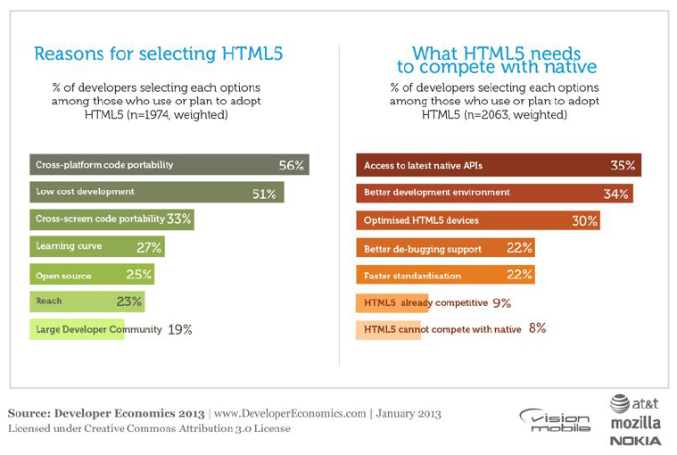
HTML5 Trades Optimization for Portability
Notes:
Quotes below from VisionMobile Developer Economics 2013
“HTML5 needs better native platform APIs, and development environment.
HTML5 is becoming a viable alternative to native for developers working on app categories such as Business & Productivity (used by 42% of HTML developers), Enterprise (32%) and Media apps (28%). To compete with native, HTML5 needs better native API access (35% of HTML developers), a better development environment (34%), better debugging support (22%). More importantly, optimised HTML5 devices were not seen as important as the native API access or dev environment. This leads us to conclude that HTML proponents such as Facebook, Mozilla and Google should focus on cross-platform tools and development environments on at least equal measures as they focus on full platform efforts like Facebook Platform, Firefox OS and Chrome OS.”
“HTML5 is becoming a viable alternative to native development across a number of app categories. In Developer Economics January 2013 we found that HTML developers mainly focus on specific app categories such as Business & Productivity (42% of HTML developers), Enterprise (32%) and Media apps (28%). On the other hand, Games are not a common category among HTML developers (12%).”
“We asked developers that use or are planning to use HTML about the reasons for platform selection. The majority indicated code portability as the main incentive for using HTML5. Low cost development is the second driving force for HTML5 adoption, highlighted by 51% of developers.”
“HTML is still an “extension platform” as we saw earlier. We asked developers that use, have used or are planning to use HTML what they think HTML5 needs to compete with native platforms. Access to native APIs is a top challenge with 35% of developers indicating this as a critical success factor. HTML5 will always be a step behind in support for native APIs, given that platform”
From Peter Lubbers’ Fall 2012 HTML5 Dev Con presentation in SFO:
– web intents
– getUserMedia
– webRTC (real time communication)
– web Audio
– Gamepad API

Slide 55
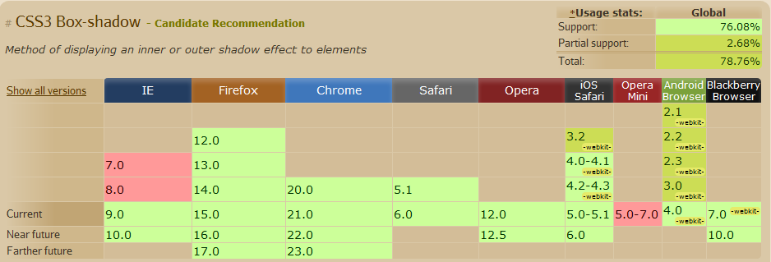
Browser Engine Differences Support of HTML5 among browsers
Source: Caniuse.com

Slide 56
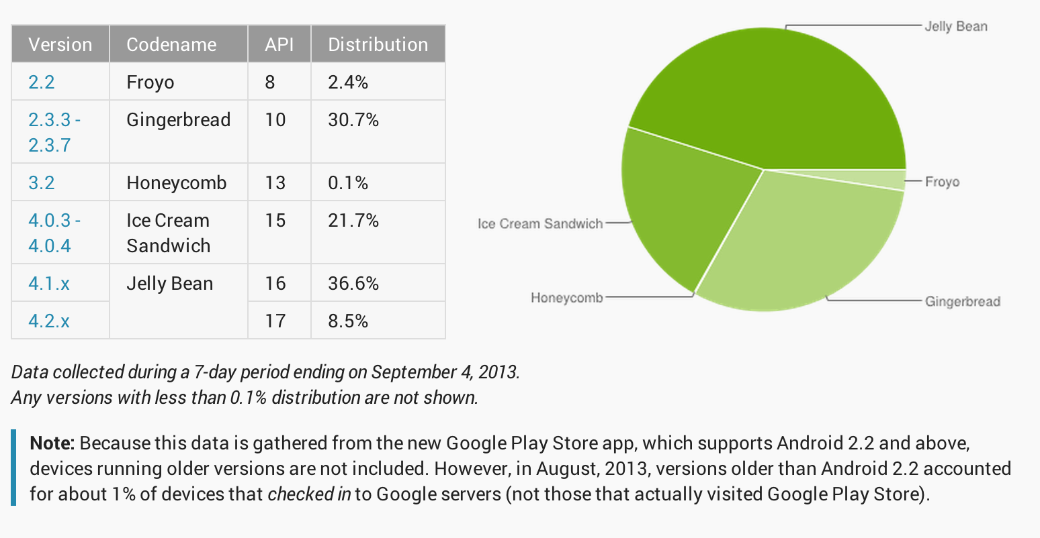
Distribution of Android Devices http://developer.android.com/about/dashboards/index.html

Slide 57
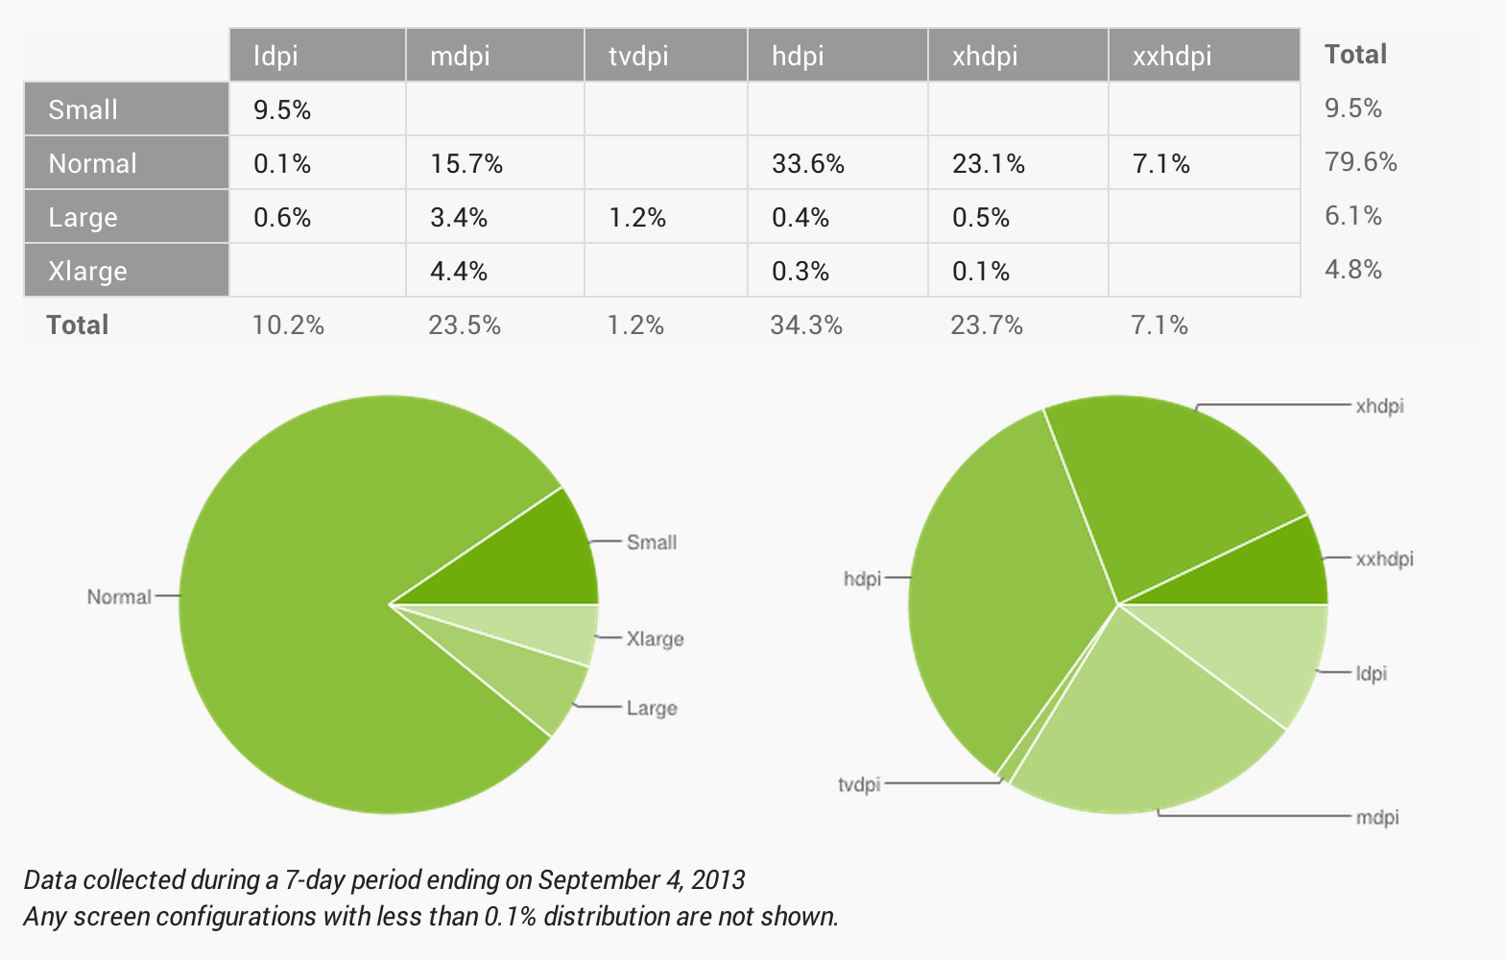
Screen Size and Densities

Slide 58
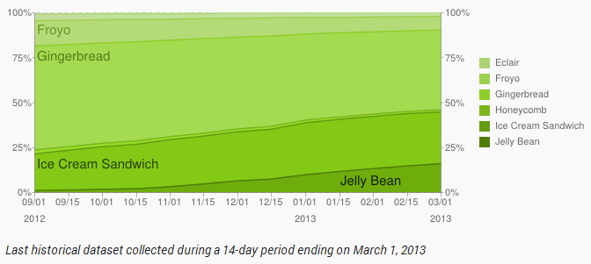
Slowly, Android 2.x will Disappear
Android 2.x is the most problematic platform
Inconsistent HTML5 support, performance issues and bugs

Slide 59
Apache Cordova* Essentials pronounced /fōn-gap/
Adobe* PhoneGap* is a “distribution” of Apache Cordova*
PhoneGap* is a trademark of Adobe*
*Other names and brands may be claimed as the property of others.

Slide 60
/fōn-gap/ is a Cross Platform Tool /fōn-gap/ is not…
…a magic elixir
won’t auto-magically make your app aware of device features
it is not a “write once run anywhere” technology (but it’s close)
…a compiler or translator
it does not convert HTML5 code into native code
…a “browser bundler”
it does not distribute a browser with your application
not like Chrome Embedded Framework (aka CEF) or Node-Webkit
…it is not the same as using tools like:
Appcelerator*
Mosync*
Marmalade*
Xamarin*
et al
Notes:
Quotes below from Vision Mobile Developer Economics 2013
“Cross-platform tools (CPTs) address real challenges for developers. Cross-platform tools allow developers to create applications for multiple platforms - usually mobile, but increasingly tablets or TV screens - from almost the same codebase or from within the same design tool. CPTs reduce the cost of platform fragmentation and allow developers to target new platforms at a small incremental cost. More importantly, cross-platform tools allow software companies targeting multiple platforms to reuse developer skills, share codebases, synchronize releases and reduce support costs.”
“CPTs can be used to develop native, hybrid and web apps and come in several technology flavors: JavaScript frameworks, App factories, Web-to-native wrappers, Runtimes and Source code translators. There are over 100 CPTs that we identified in our Cross Platform Tools report published in February 2012.”

Slide 61
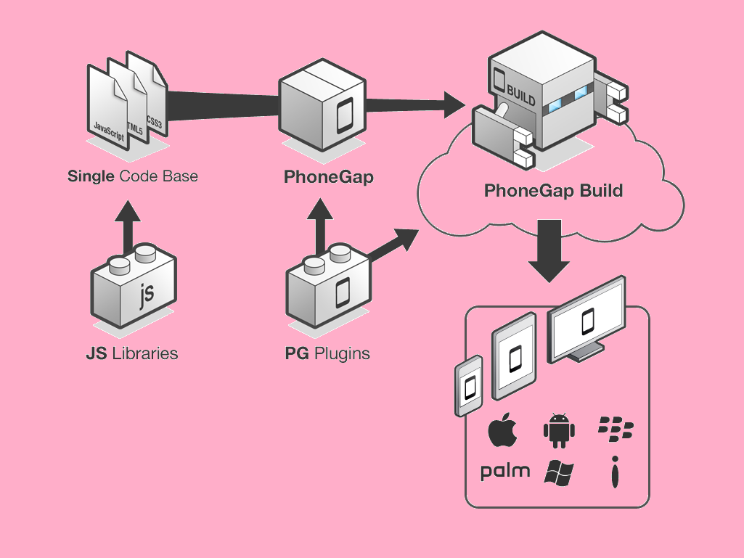
Apache Cordova (/fōn-gap/) Device APIs
Accelerometer
Camera
Capture
Compass
Connection
Contacts
Device
Events
File
Geolocation
Globalization
InAppBrowser
Media
Notification
Splashscreen
Storage
Notes:
Accelerometer – Tap into the device's motion sensor.
Camera – Capture a photo using the device's camera.
Capture – Capture media files using device's media capture applications.
Compass – Obtain the direction that the device is pointing.
Connection – Check network state and cellular network information.
Contacts – Work with the devices contact database.
Device – Gather device specific information.
Events – Hook into native events through JavaScript.
File – Hook into the native file system through JavaScript.
Geolocation – Make your application location aware (GPS).
Globalization – Enable representation of objects specific to a locale.
InAppBrowser – Launch URLs in another in-app browser instance.
Media – Record and play back audio files.
Notification – Visual, audible, and tactile device notifications.
Splashscreen – Show and hide the applications splash screen.
Storage – Hook into the devices native storage options.

Slide 62
Apache Cordova (/fōn-gap/) API Sampling
Accelerometer
navigator.accelerometer.getCurrentAcceleration(accSuccess,accError);
var watchID = navigator.accelerometer.watchAcceleration(accSuccess,accError,[accOptions]);
navigator.accelerometer.clearWatch(watchID);
Camera
navigator.camera.getPicture(cameraSuccess,cameraError,[cameraOptions]);
navigator.camera.cleanup(cameraSuccess,cameraError);
Compass
navigator.compass.getCurrentHeading(compassSuccess,compassError,compassOptions);
var watchID = navigator.compass.watchHeading(compassSuccess,compassError,[cOptions]);
navigator.compass.clearWatch(watchID);
Geolocation
navigator.geolocation.getCurrentPosition(geoSuccess,[geoError],[geoOptions]);
var watchId = navigator.geolocation.watchPosition(geoSuccess,[geoError],[geoOptions]);
navigator.geolocation.clearWatch(watchID);
ref: http://docs.phonegap.com

Slide 63
Apache Cordova Platform Support Levels
Core – primary platforms supported by Apache Cordova
iOS
Android
BlackBerry
Windows Phone 7 & Windows Phone 8
Horizon –some level of support, future core support candidates
Tizen
Qt
Firefox OS
Ubuntu Mobile (Qt)
Windows Desktop (Win32)
Sunset –code available, but no distribution of these platforms
Symbian
webOS
Bada
ref: http://wiki.apache.org/cordova/PlatformSupport
Notes:
Core platforms target an operating system, with devices in circulation, providing:
A standard low level native plugin bridge API (and related utilities)
Standard set of low level CLI tools
Embeddable (if possible)
InAppBrowser and other browser-ish shims like alerts, etc

Slide 64
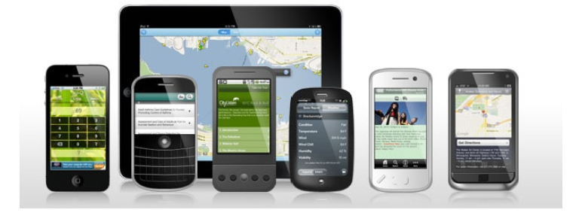
Apache Cordova Method of Operation
Write your HTML5 “web app” using HTML/CSS/JavaScript
Open a “native web-view” inside a “native app”
Package your “web app” inside that “native web-view”
Deploy your “web app” as a “hybrid native app”
ref: http://wiki.apache.org/cordova/AddingNewPlatforms
Notes:
Instantiate a “chromeless” browser (or WebView)
iOS WebView
Android WebView
BlackBerry WebWorks framework
Windows Phone 7 WebBrowser
Load packaged www assets (HTML/CSS/JS)
i.e., point the WebView at your index.html file
Enable the native framework → web view bridge
ref: http://wiki.apache.org/cordova/AddingNewPlatforms

Slide 65
Apache Cordova Application Block Diagram
cordova.js
Your Web App
cordova plugins
Native Web Runtime
System Services
Operating System
Mobile Device Hardware

Slide 66



Just Think of it as a Tasty “Black and Tan”
(if you don’t like beer, think of Cordova as an “Arnold Palmer”)
Web App Stuff (stout)
/fōn-gap/ stuff
Native App Stuff (pale ale)

Slide 67
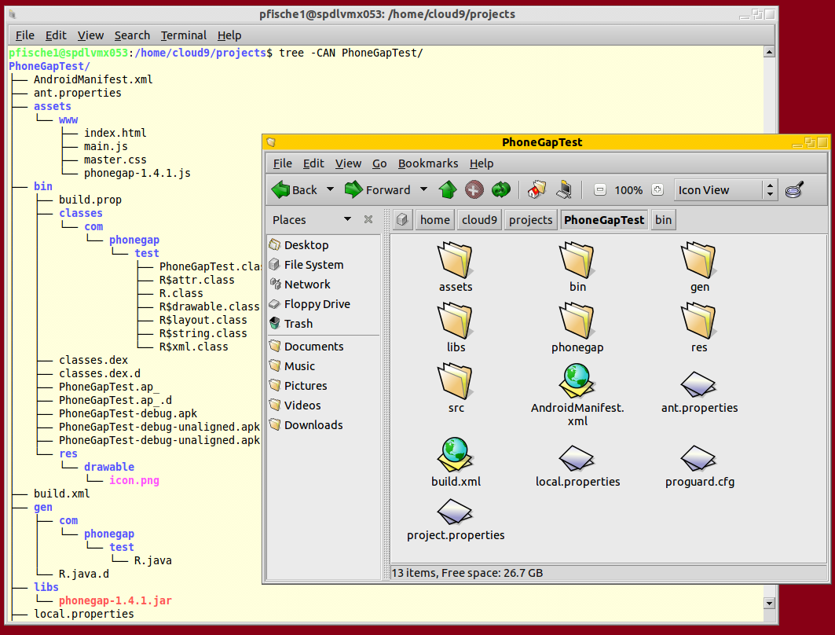

Android SDK and /fōn-gap/ Project Example

Slide 68
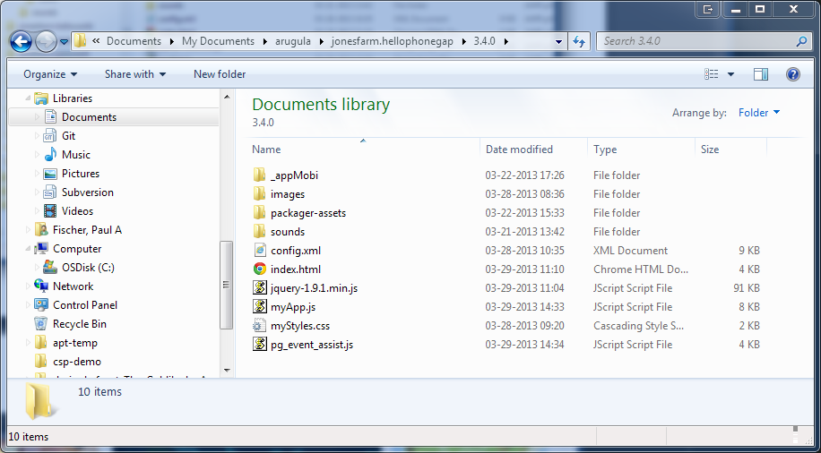
HTML5 Device App on My Local Disk
config.xml gives directions to the build process

Slide 69
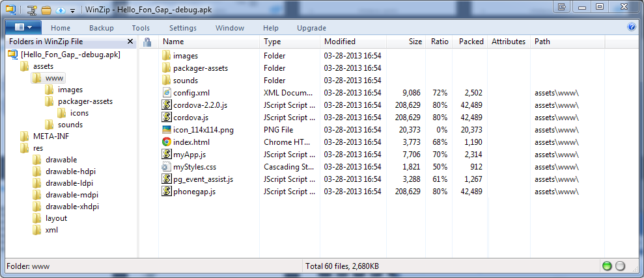
HTML5 Device App in an Android APK
an APK is just a zip file
build process adds some /fōn•gap/ specific files

Slide 70
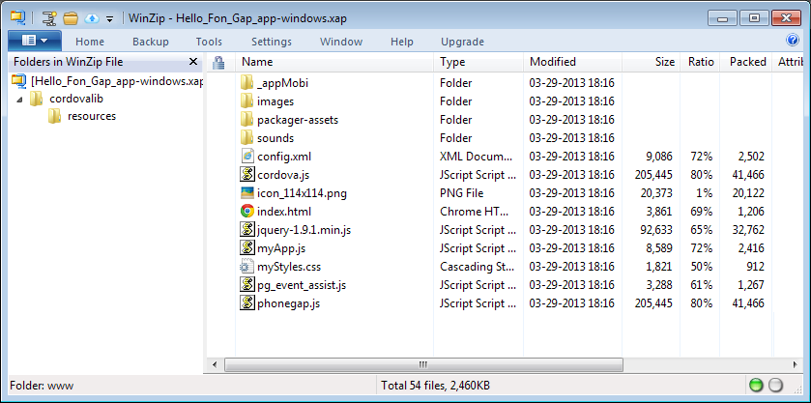
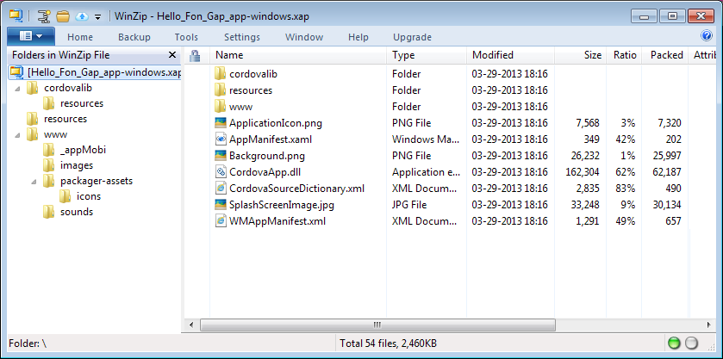
HTML5 Device App in a Windows Phone XAP
an XAP is also just a zip file
some of the “native wrapper” bits in a Windows Phone app

Slide 71

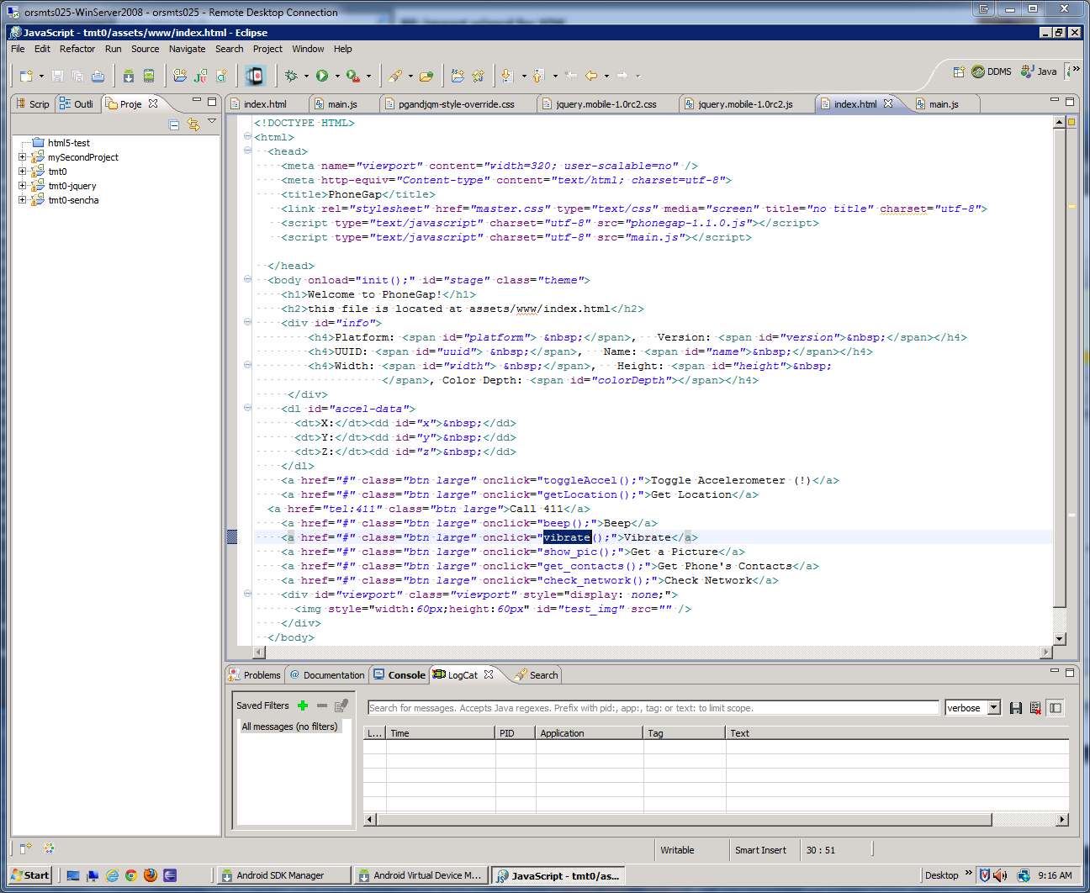
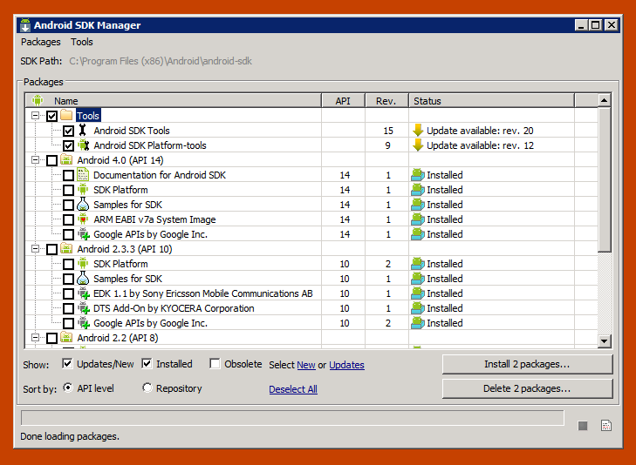


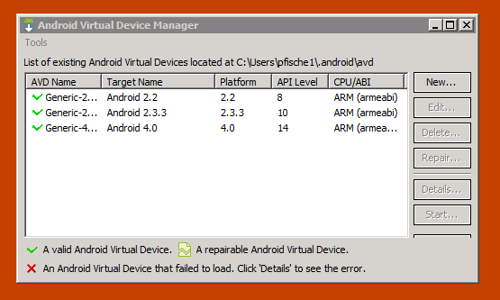
With Cordova do I Have to Learn to use the Android, Xcode and Visual Studio ’12 SDKs!?

Slide 72
Intel® XDK Handles the Cordova Stuff!
The Intel XDK tools facilitate the creation of hybrid HTML5 applications for deployment on iOS, Android, Windows 8, Tizen and other mobile devices.
Visit the Intel Developer Zone → software.intel.com/html5

Slide 73
HTML5 Basics

Slide 74
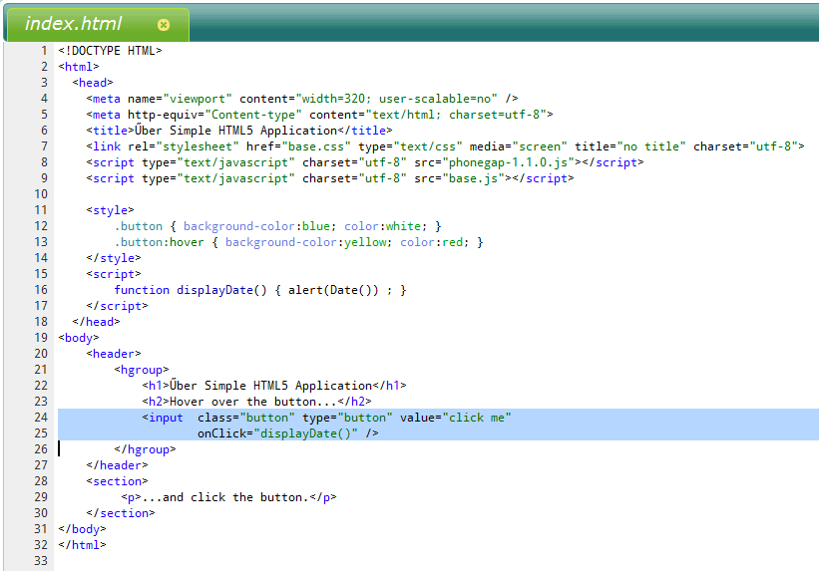
What is an HTML5 Application?
body
header
hgroup
h1
nav
div
h2
ul
li
li
li
section
header
h1
p
section
h1
p
aside
p
An application built around an…
event-driven
object-oriented
programming environment
And built using…
HTML Elements
document objects (DOM)
CSS Rules
style sheets
JavaScript Code
event-handlers
object manipulation
general logic processing

Slide 75
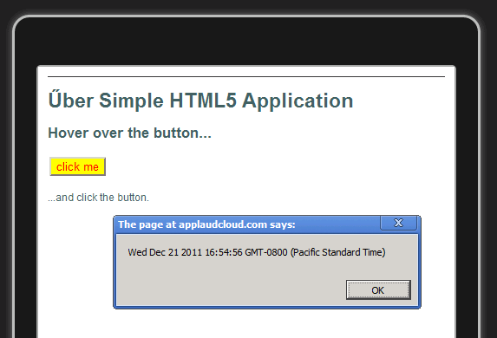
Űber Simple HTML5 “Application”

Slide 76
HTML5 Programming Recommendations
Use HTML Pages to Structure Your Application
identify functional areas and use structural tags
w3schools.com/html5/html5_new_elements.asp
Use CSS for Design and Layout
separate content from presentation
design for alternate layouts (phone versus tablet)
w3schools.com/cssref/
Use JavaScript for Action and Events
take action on events (click, document load, etc.)
read and write HTML elements (modify page elements)
validate data input (form data, etc.)
communicate with external agents (web workers, etc.)
w3schools.com/js/js_intro.asp

Slide 77
Differences Between Mobile and Desktop
Both use HTML, CSS and JavaScript
both support [most] current HTML5 features
Features [Mostly] Unique to Desktop
mouse interaction and hi-res multi-window display
plug-ins to extend web applications and pages
reliable connections with fast speeds
Features [Mostly] Unique to Mobile
touch interaction on lo-res single-window display
few [if any] plug-ins to extend web applications
unreliable connections with variable speeds
access to device hardware (motion, location, etc.)
access to personal features (calendar, contacts, etc.)

Slide 78

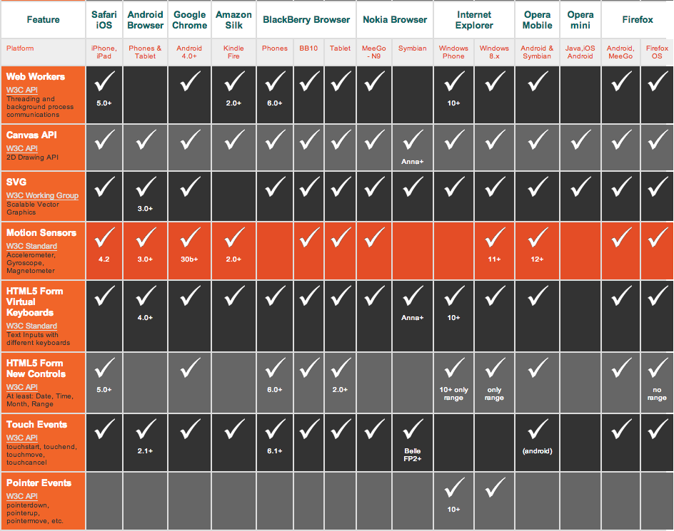
Which HTML5 Features Can I Use?
Mobile compared to W3C standards …according to mobilehtml5.org
And see… caniuse.com for browser capabilities

Slide 79
Core and Common HTML Elements (tags)
<html>, <head> and <body>
core page structure elements
define basic structure of every page
<p>, <a>, <h#>, <li>, <table>, <img>… <form>, <input>, <link>, <style>, <script>… <!-- this is an HTML comment -->
commonly used elements (aka tags)
<div> and <span>
generic block and inline elements (respectively)
frequently used with global “class” and “id” attributes
w3schools.com/html5/html5_reference.asp

Slide 80
Key New HTML5 Semantic Elements
<section>, <article> and <aside>
represent document segment blocks
<hgroup>, <header>, <footer> and <nav>
introductory and follow-up segments
e.g., may contain navigational links
<time>, <figure> and <figcaption>
time/date mark and “self-contained content”
more details:
diveintohtml5.info/semantics.html#new-elements
whatwg.org/specs/web-apps/current-work/multipage/
dev.w3.org/html5/markup/elements.html#elements
w3.org/wiki/Category:HTMLElement

Slide 81
HTML Element Attributes
A Few Key Attributes
“id” typically used to uniquely identify an HTML element
“class” typically used to apply CSS styling rules
“name” typically used to identify form input elements
Event Handler Attributes
onclick: occurs when a mouse clicks the element w3schools.com/jsref/tryit.asp?filename=tryjsref_onclick
onfocus: occurs when an element gets focus
onload: occurs immediately after a page is loaded
onmouseover: occurs when mouse hovers over element
onselect: occurs when text is selected
developers.whatwg.org/elements.html#global-attributes

Slide 82
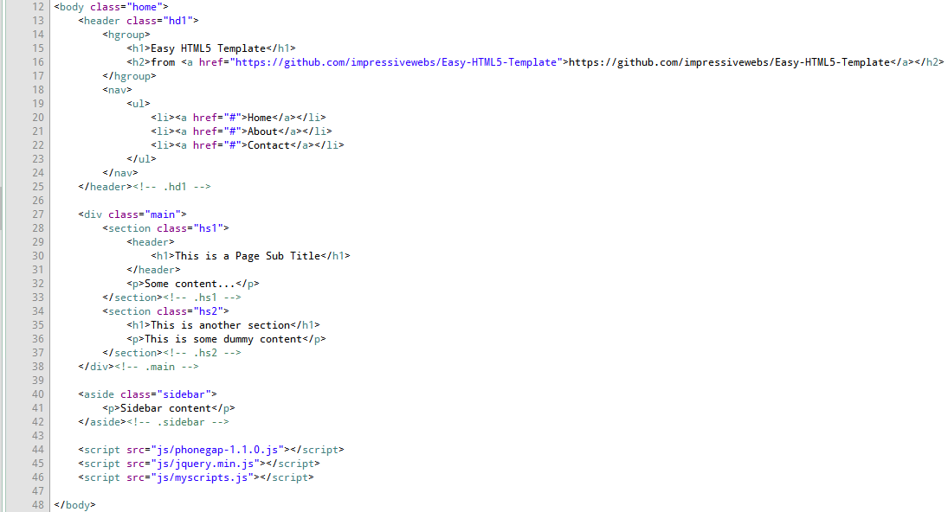
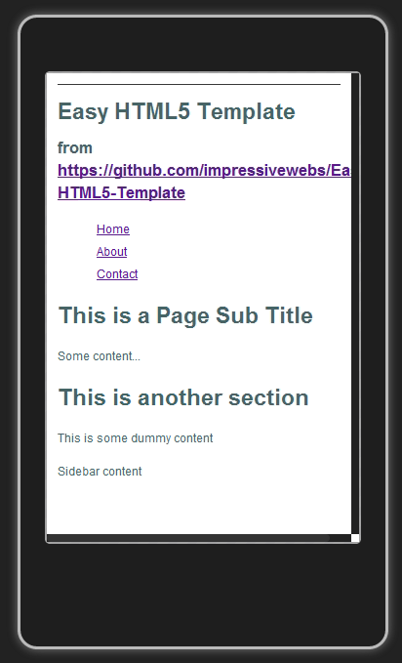
Simple HTML5 DOM Example

Slide 83
DOM Structure of Simple Example Useful for Defining CSS Selectors
body “home”
header “hd1”
hgroup
h1
nav
div “main”
h2
ul
li
li
li
section “hs1”
header
h1
p
section “hs2”
h1
p
aside “sidebar”
p

Slide 84
HTML DOM Objects
HTML Objects and Properties
HTML elements are objects ➔ document.forms[x].elements[y]
form fields, buttons, images, links, divs, etc. are all objects
W3C HTML DOM
Document Object Model (W3C standard)
defines objects, properties and methods to access and manipulate HTML elements
Chrome Console Examples (Ctrl+Shift+J)
document.images
document.bgcolor = "orange"
eobjs = document.getElementsByTagName("div") for(i in eobjs) console.log(eobjs[i].id)
w3schools.com/jsref/dom_obj_document.asp

Slide 85
HTML DOM Properties and Methods
Properties are something (e.g., node name)
x.innerHTML – the text value of x
x.nodeName – the name of x
x.nodeValue – the value of x
x.parentNode – the parent node of x
x.childNodes – the child nodes of x
x.attributes – the attributes of x
Methods do something (e.g., add/remove a node)
x.getElementById(id) – get element with specific id
x.appendChild(node) – add a child node to node x
x.removeChild(node) – remove a child node from node x

Slide 86
Locating DOM Elements using JavaScript
Element Attribute Functions
getElementById()
getElementsByClassName()
getElementsByTagName()
DOM Traversal Functions
childNodes()
nextSibling()
parentElement()
Selectors API Functions
querySelector()
querySelectorAll()
www.webdirections.org/blog/ html5-selectors-api-its-like-a-swiss-army-knife-for-the-dom/
86

Slide 87
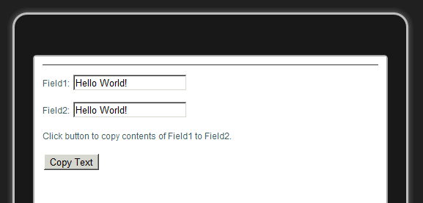
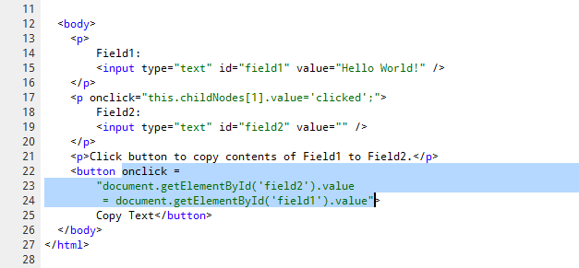
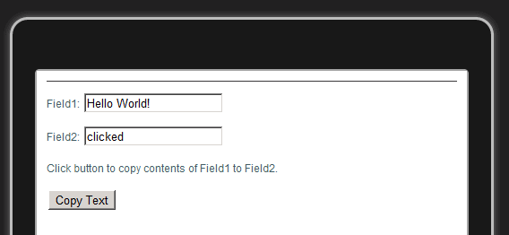
HTML DOM Events
Events trigger JavaScript execution
example: onclick = "my JavaScript code here ;"
onmouseover, onmousedown, onfocus, onchange, etc.
Example: “execute script when element is clicked”

Slide 88
JavaScript Usage
Event Handling and User Interaction
click, touch, change, error, etc.
Data entry (text, numbers, dates, …)
DOM Modifications
Add and remove elements
Show and hide elements
Alter element properties and style definitions
JavaScript Elements
Functions and Libraries
Data types consist of:
string, boolean, number, objects (JSON), arrays, etc.
w3schools.com/jsref

Slide 89
Change HTML Element with JavaScript – using innerHTML
<html> <body> <p id="p1">
Hello World!
</p> <script type="text/javascript"> document.getElementById("p1").innerHTML="New text!"; </script> </body> </html>
w3schools.com/jsref/tryit.asp?filename=tryjsref_elmnt_innerhtml

Slide 90
Change HTML Element with JavaScript – using an event
<html>
<body>
<input type="button"
onclick="document.body.bgColor='lavender' ;"
value="Change background color"
/>
</body>
</html>

Slide 91
Change HTML Element with JavaScript – using styles (CSS)
<html>
<head>
<script type="text/javascript">
function NewStyle() {
document.getElementById("p1").style.color="blue";
document.getElementById("p1").style.fontFamily="Arial";
}
</script>
</head>
<body>
<p id="p1">Hello world!</p>
<input type="button" onclick="NewStyle()" value="New Style" />
</body>
</html>

Slide 92
JavaScript Libraries
General Purpose JavaScript Libraries
microjs.com → long list of small libraries
jquery.com → probably the most popular library
docs.jquery.com/How_jQuery_Works
zeptojs.com → jQuery clone (assumes HTML5 support)
Device Access Libraries
docs.phonegap.com → de facto device access API standard
w3.org/2009/dap → evolving device access API standards
w3.org/2012/sysapps → system application API standards
wacapps.net → app packaging and device API standard
Packing, Minimizing and Obfuscating Libraries
compression, white space removal, token substitution…
code.google.com/speed/page-speed/docs/payload.html

Slide 93
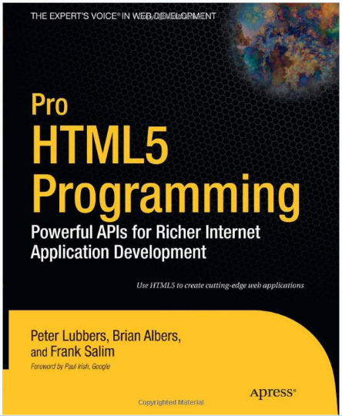

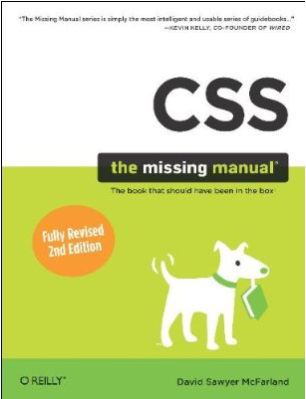
HTML5, JavaScript and CSS Books
Pro HTML5 Programming → by Peter Lubbers
JavaScript: The Good Parts → by Douglas Crockford
CSS: The Missing Manual → by David McFarland

Slide 94
A Few Useful HTML5 References
WHATWG Specification
whatwg.org/specs/web-apps/current-work/multipage/
W3C Standards
w3.org/standards
Learning HTML5 Resources
diveintohtml5.info
html5rocks.com/en/tutorials
webmonkey.com/tutorials
w3schools.com/html5
JavaScript Libraries
jquery.com
microjs.com

Slide 95
CSS (Cascading Style Sheets)

Slide 96


CSS3 Styling Examples
Zen Garden Demonstration
www.csszengarden.com
Useful CSS Examples
www.the-art-of-web.com
96

Slide 97
Basic CSS Selectors
Any HTML Element (e.g., a Tag)
p { text-indent: 3em; }
Class (.label) and ID (#label) Attribute Selectors
.note { font-size: small; }
#paragraph { text-align:center; color:red; }
Contextual Selectors
p em { background: yellow; }
(<em> contained within a <p>)
Grouping Selectors
h1, h2, h3 { color: red; font-family: sans-serif; }
Cascading Selectors Determine Order of Precedence
“importance,” “specificity,” “order defined,” etc.
97

Slide 98
Complex CSS Selectors w3.org/TR/2009/PR-css3-selectors-20091215/
A selector is used as a condition to determine which elements a style rule matches in the DOM.
CSS 1 example: p:hover, p:focus {…}
CSS 2 example: span[class="example"] {…}
CSS 3 example: object[type^="image/"] {…}
E:active, E:hover, E:focus | an E element during certain user actions
E[foo="bar"] | an E element whose "foo" attribute value is exactly equal to "bar"
E[foo^="bar"] | an E element whose "foo" attribute value begins exactly with the string "bar"
98

Slide 99
CSS Pseudo-Class Selectors
“To permit selection based on information that lies outside of the document tree (the DOM).”
:first-child → ol > li:first-child { font-weight : bold }
make first "li" child element of "ol" element bold
:link and :visited → a.external:visited { color: blue }
causes "a.external" link to be blue if visited
<a class="external" href="http://intel.com/">Intel</a>
:hover, :active and :focus → a:hover { color : fuchsia }
make any "a" element (link) turn fuchsia when hovered over
99

Slide 100
CSS Pseudo-Element Selectors
“To create abstractions about the document tree beyond those specified by the document language.”
:first-line → p:first-line { text-transform: uppercase }
uppercase first displayed line of each "p" element
:first-letter → p:first-letter { font-size: 200% }
large initial cap at beginning of "p" element
:before → h1:before {content: counter(chapno, upper-roman) ". "}
add a chapter number before the "h1" element
100

Slide 101
Important Features Added with CSS3
Box and Text Effects
shadows, outlines, rounded corners, rotate, etc.
Multi-column Layout
number of columns, rule width, etc.
Animation and Transitions
rate and cycles
Gradients and Opacity
radial and linear, multiple stops
Reflections and Transformations
scale, rotate, skew, move page elements
Web Fonts
code.google.com/webfonts
101

Slide 102


Tools to Understand and Build CSS Rules
www.css3.info
css3please.com
css3generator.com
westciv.com/tools/
102

Slide 103

CSS Gradient Tools and more…
gradients.glrzad.com
display-inline.fr/projects/css-gradient
103

Slide 104
Some CSS References to Get Started (in no particular order or preference)
htmlhelp.com/reference/css
www.w3.org/MarkUp/Guide/Style
www.w3schools.com/css/css_intro.asp
en.wikipedia.org/wiki/Cascading_Style_Sheets
www.addedbytes.com/cheat-sheets/
www.w3avenue.com/2009/06/22/css3-unleashed-tips-tricks-and-techniques/
www.w3avenue.com/2009/05/04/list-of-really-useful-tools-for-css-developers/
www.webdirections.org/blog/html5-selectors-api-its-like-a-swiss-army-knife-for-the-dom/
104

Slide 105
JavaScript

Slide 106
JavaScript Basics
C/C++ style syntax:
if, while, for, switch, … statements
Dynamic typing:
var x = “somestring”
(typeof x) returns “string”
Functions are first class entities:
var f = function(s) {…}
Runtime evaluation of statements and expressions:
foo = 2; alert eval (‘foo + 2’)
106
106

Slide 107
JavaScript Arrays
Initialize:
var a = new Array (“starbuck”, “boomer”, “athena”);
var a = [“starbuck”, “boomer”, “athena”];
a[0] = “starbuck”; a[1] = “boomer”; a[2] = “athena”;
Manipulate:
a.sort(); // a == [“athena”, “boomer”, “starbuck”]
a.toString(); // returns: “athena,boomer,starbuck”
a.pop(); // returns: “starbuck”, a == [“athena”, “boomer”]
a.reverse();
Iterate over contents:
for (i=0; I < a.length; i++) …
for (e in a) …
a.forEach (function (e) {…})
107
107

Slide 108
JavaScript Objects
Constructor function:
function Car (make, model) { this.make = make; this.model = model; this.miles = 0; this.drive = function (miles) {this.miles += miles} }
Instance creation:
var myCar = new Car (“Ford”, “Mustang”);
References:
var m = myCar.model; // m == “Mustang”
Operations:
myCar.drive (100); // myCar.miles == 100
Static methods:
Car.milesToKm = function (miles) {return 1.6*miles}
108
108

Slide 109
JavaScript Builtin Objects
Strings:
Constructor Examples:
var s = new String (“abc”);
var s = “abc”;
Properties Example:
var len = s.length; // len == 3
Method Example:
var supper = s.toUpperCase ()); // supper == “ABC”
Date:
Constructor Examples:
var d = new Date (“December 24, 2011 11:13:00");
var d = new Date (2011, 11, 24, 11, 13, 0);
Method Examples:
var y = d.getFullYear (); // y == 2011
var dstr = d.toDateString (); //dstr == “Sat Dec 24 2011”
Other builtin objects:
Array, Number, Math, Boolean, Object, RegExp
109
109

Slide 110
JavaScript Arrays and Objects
An object can be viewed as an associative array:
var myCar = new Car (“Ford”, “Mustang”);
myCar [“make”] == myCar.make
Iterate through an object:
for (e in myCar) // e will cycle through “make”,“model”,“miles”,“drive”
110
110

Slide 111
JavaScript Prototypes
Extending all instance objects with properties and methods:
Used to implement ‘poor man’s’ inheritance
Date.prototype.hourInMilliseconds = 60*60*1000;
Date.prototype.addHours =
function (hours) {
this.setTime(
this.getTime() + hours*this.hourInMilliseconds)
};
var d = new Date ();
d.addHours (10); // d == now + 10 hours
111

Slide 112
JSON
JavaScript Object Notation
Convenient for data exchange between client and server
JSON parsers available in server-side scripting languages
Example:
var myCars = [
{"make" : "Ford",
"model" : "Mustang",
"year" : 2007},
{"make" : "Ford",
"model" : "Bronco",
"year" : 1989}
];
for (i in myCars) {
alert (myCars[i].year + " " +
myCars[i].make + " " +
myCars[i].model);
}
112
112

Slide 113

JavaScript Callbacks and Events
Callbacks are invoked when events happen:
User clicks a button
Mouse Moves
Key on keyboard pressed
Data is available from data source (SQL, Web-service,…)
Enables scripts to act as event-driven modules
<HTML>
<HEAD><SCRIPT>
function reportMousePos() {
var posBox = document.getElementById("pos");
posBox.innerHTML = window.event.x + "," + window.event.y;
}
</SCRIPT></HEAD>
<BODY>
<DIV>POS: <SPAN id="pos"></SPAN></DIV>
<DIV id="box"
style="border:4px solid black;width:100px;height:100px"
onmousemove="reportMousePos();">
</DIV>
</BODY></HTML>
113
113

Slide 114
JavaScript Namespaces and Closures
Pollution of global name space is a problem!
<script src=“season2.js”> // defines function getEpisode()
<script src=“season3.js”> // defines function getEpisode()
Solution: “hand” implementation of namespaces
No syntactic support in Javascript
Drawback: everything is “public”
bsg becomes only name in global namespace
var bsg = {
"season3" : [ "Occupation", "Precipice", "Exodus1" ],
"getEpisode" : function (episodeNumber) {
return bsg.season3 [episodeNumber-1];
}
}
var Ep2 = bsg.getEpisode (2);
var Ep1 = bsg.season3 [0]; // possible, but probably not intended
Then use ‘bsg.name’ to access internal members
114

Slide 115
JavaScript Namespaces and Closures
“Better” solution
var bsg2 = function () {
// a 'private' member
var season3 = ["Occupation", "Precipice", "Exodus1" ];
// a 'private' method
var getEpisode = function (episodeNumber) {
return season3 [episodeNumber-1];
}
return {
// exports 'getEpisode' to public
"getEpisode" : getEpisode
};
}(); // Note ()! The anonymous function is called immediately
var Ep2 = bsg2.getEpisode (2);
var Ep1 = bsg2.season3 [0]; // Not possible
115

Slide 116
JavaScript Exception Handling
try – catch – finally - throw syntax
Internal exceptions:
EvalError: Error during call to eval()
RangeError: Number outside legal range (e.g. negative size of array)
ReferenceError: Illegal reference (e.g. undefined variable)
SyntaxError: Syntax error in eval() call
TypeError: Unexpected variable type
URIError: Error encoding or decoding a URI
User thrown errors:
throw new Error (“User exception raised”);
116
116

Slide 117
JavaScript Exception Handling
try {
if (...) {
throw new Error ("explicitly thrown error");
}
else {
x = y; // ReferenceError (y is not defined)
}
}
catch (e) {
alert (e.name + ":" + e.message);
}
finally {
// this part is optional,
// but always executed, if present
alert ("Done");
}
117
117

Slide 118
jQuery

Slide 119


jQuery Background
www.jquery.com
Created by John Resig
First released in January, 2006
Open Source Dual License (MIT/GPL V2)
Used by ~42% of ALL web-sites as of 12/20/2011
Hides browser differences
Unified event handling
Unified DOM selection model
Unified AJAX handling
Simpler and easier coding
$("node") instead of
document.getElementById("node")
119

Slide 120
jQuery DOM Manipulation
Primary Purpose of jQuery Library
DOM elements (DIV, SPAN, etc) can be:
Inspected: .text(), .html(), .val()
Created: .text("Hello World") or $("<DIV>Hello</DIV>")
Inserted: .append(), .prepend(), .before(), .after()
Removed: .remove()
Classes on DOM elements can be:
Inspected: .hasClass()
Added: .addClass()
Removed: .removeClass()
Toggled: .toggleClass ()
Attributes on DOM elements can be:
Inspected: .attr ("attribute name")
Modified: .attr ("attribute name", "new value")
120

Slide 121

jQuery Selectors - Basic
Select DOM elements by:
element (BODY, DIV, etc.)
id (id given to element, e.g. <DIV id="divid">
class (class given to element, e.g. <DIV class="divclass">
Returns one or many matches from DOM
<SCRIPT>
$(document).ready (function () {
$("div").text ("hello");
$("#divid").append ("<SPAN> id selector</SPAN>");
$(".divclass").append ("<SPAN> class selector</SPAN>");
});
</SCRIPT>
</HEAD>
<BODY>
<DIV></DIV>
<DIV id="divid"></DIV>
<DIV class="divclass"></DIV>
</BODY>
121

Slide 122

jQuery Selectors - Advanced
<SCRIPT>
$(document).ready (function () {
$("[title]").text ("jQuery - the best thing since sliced bread");
$("[footer='copyright']").text ("Copyright: Peter Jensen");
$("[footer='page_number']").text ("Page 1");
});
</SCRIPT>
</HEAD>
<BODY>
<DIV title></DIV>
<DIV content></DIV>
<DIV footer="copyright"></DIV>
<DIV footer="page_number"></DIV>
</BODY>
122

Slide 123
jQuery Animation Effects
Control animated behaviors
Fading: .fadeIn(), .fadeOut(), .fadeTo()
Sliding: .slideDown(), .slideUp(), ...
Custom: .animate() → change any numerical CSS attribute
<SCRIPT>
$(document).ready (function () {
$("#box").fadeIn (2000, function() {
$("#box").fadeOut (2000);
});
});
</SCRIPT>
<STYLE>
.box {
width:50px; height:50px;
background-color: blue;
display:none;
margin:5px;
}
</STYLE>
</HEAD>
<BODY><DIV id="box" class="box"></DIV></BODY>
123

Slide 124

Attaching and Detaching Event Handlers to DOM Elements
$.on()
$.off()
$.one()
124

Slide 125
jQuery Plugins
Extensions to standard jQuery
Additional effects
Slideshows
Animated menus
etc.
plugins.jquery.com
Easy to use
<SCRIPT src=“plugin-name.js”></SCRIPT>
Plugin Examples
App Framework
jQuery Mobile
jQuery UI
many others…
125

Slide 126
jQuery Mobile and jQueryUI Plugins
jQuery Mobile
Touch event handling
Designed for tablets and smartphones
Multiple ‘pages’ in one web-page
Built-in features for navigation (lists, back buttons)
jQuery UI
Desktop like UI elements for web-pages/apps
Draggable, droppable, resizeable, selectable, sortable elements
Accordion containers, date pickers, dialog boxes, etc.
Animations
126

Slide 127
Chrome Dev Tools (CDT)

Slide 128

Debug Tools for Chrome Browser
≡ → Tools → Developer Tools
Develop, Debug and Profile
JavaScript Debugger
Interactive JavaScript Console
Dom Inspector
Profiling Tools
CPU
Memory
Network
Auditing tools
Automatic suggestions for improvement
Safari, Firefox, Opera and IE include equivalent tools

Slide 129

CDT Elements Tab
Lists entire DOM tree
Interactive and editable
Click on element in viewport to see properties in CDT
Hover over element in CDT to highlight rendered area in viewport
Notes:
In the resources tab you can edit the contents and your edits are reflected in the webpage frame. Hovering over elements highlights the corresponding portion of the webpage. When you click on a selection in the right pane, the left pane displays its properties: Styles, where the css rules originated, html properties, DOM breakpoints and event listeners, &c.

Slide 130

CDT Resources Tab
Lists all resources on the page, including:
html files
script files
CSS files
image files
Select resource in left pane of CDT to see preview in right pane of CDT
Notes:
Selecting an image file in left pane shows image in right, selecting source file shows source text, &c.

Slide 131

CDT Sources Tab – JavaScript Debugger
CDT left pane → Source
Breakpoints
Hover over variables to see values
CDT right pane → Data
Watch points
Call Stack
Properties
Breakpoints
DOM breakpoints
Event listeners
note: old screen shot shown here, “Scripts” tab is now labeled “Sources”

Slide 132

CDT Console Tab – Interactive JavaScript
Evaluate JavaScript expressions interactively in the console
Modify DOM with JS calls and assignments
Console interface includes name completion (variables, fields, functions)

Slide 133

CDT Network Tab
Network profile for each resource on a page
Hovering over a particular timeline provides more details on where time is spent
Blocking, Connecting
Sending
Waiting
Receiving

Slide 134

CDT Timeline Tab
Time duration and event details for elements
Network Resources
JavaScript parsing
Layout rendering
Helps you understand the interactions in a webpage and analyze performance bottlenecks.

Slide 135

CDT Profiles Tab
JavaScript Profiler
Time spent in JavaScript functions
Heap Snapshot
Memory distribution of JavaScript objects
CSS Selector Profiler
Time spent matching selectors
CSS selector matches

Slide 136

CDT Audits Tab
Analyzes and provides suggestions to improve
Page load time or network utilization
Web page rendering and script performance

